Slide 1
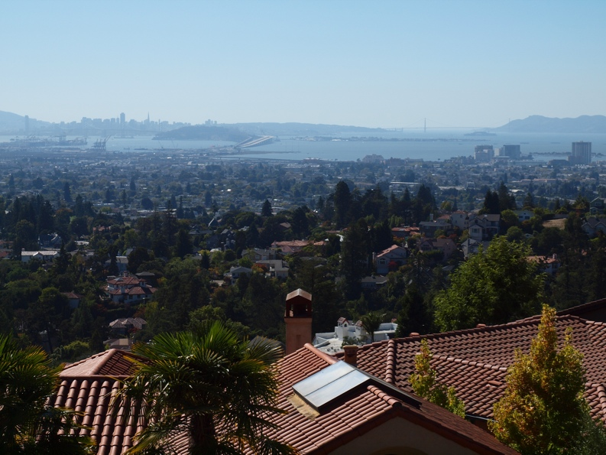
Enabling Informed Participation in Governance (EIPIG)
Hans-Peter Plag, Mitigation and Adaptation Research Institute,
Old Dominion University, Norfolk, VA, USA
1

Slide 2
C4: Services for the Coastal Zone
Leads: USA (NOAA) and IEEE (hpplag@odu.edu)
Priority Actions
• Develop a global coastal zone information system: a global cyber-infrastructure that will provide access to available information on coastal zones and facilitate the collection of new information through crowd-sourcing and citizen-science
• Implement a pilot project in an area-at-risk (e.g. Indonesian Archipelago-South China Sea domain) to demonstrate the added-value of ecosystem-based approaches for monitoring and managing the coastal zone. This will be coordinated with GOOS Regional Associations and global/regional networks (see Plan of the Panel for Integrated Coastal Observations)
• Assess climate change impacts on island coasts for islands from the Caribbean to the Arctic using SAR data and other relevant data as a demonstrator for the use of space-based observations in the monitoring of climate change impacts. Data for this activity would be sought from CEOS members
• Assess the observational requirements for decadal forecasts of coastal local sea-level variation and develop a demonstrator forecasting service
• Assess user needs and observational requirements for coastal water quality (using the GEOSS User Requirements Registry); identify indicators and best practices for coastal water quality, and implement a monitoring service pilot for coastal water quality (with WA-01 and HE-01); disseminate information particularly to under-served communities (with IN-04)

Slide 3

User Requirements Registry (URR):
Engaging (S&T) communities in telling us what they (and others) need
Enables gap analysis
Supports prioritizing and identification of benefits

Slide 4
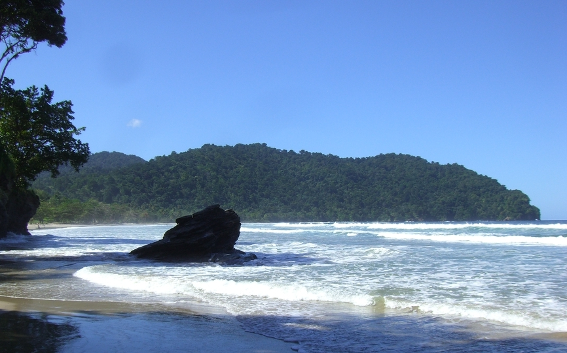
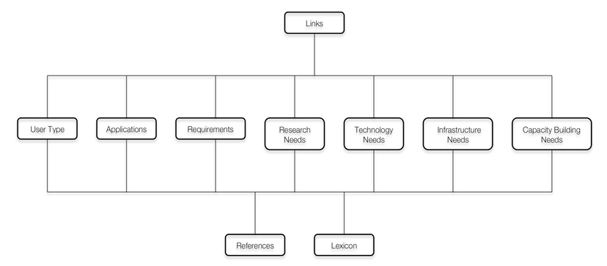
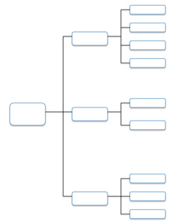
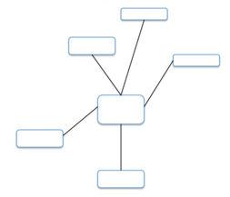
Approach:
(1) Global, application-focused view;
(2) Add all other information on a local level.
7

Slide 5
User Requirements Registry (URR):
Engaging (S&T) communities in telling us what they (and others) need
Enables gap analysis
Supports prioritizing and identification of benefits
Socio-Economic and Environmental Information Needs Knowledge Base (SEE IN KB)
Linking societal goals and targets to indicators and EVs
Deriving observational requirements
Linking requirements to deliverables
Identifying gaps
Prioritizing

Slide 6
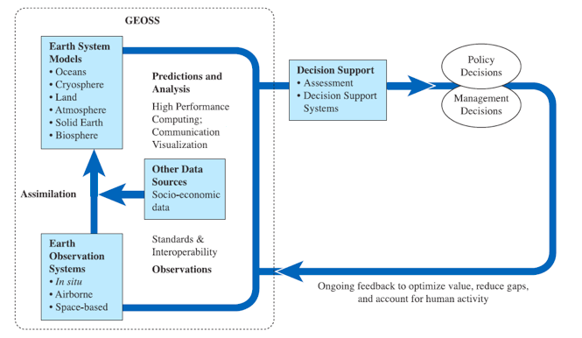


From Access For, to Dialog With, User Communities
Implementing GEOSS depends on input from Stakeholder communities
Information Needs
GEO Portal
GEO has unique convening power …
Bidirectional Information Systems
Opportunity: Convene the collaborative development of open-source, bi-directional information system of systems
URR
Stakeholder Driven GEOSS
GEO, 2005. 10-YIP Reference Document.

Slide 7


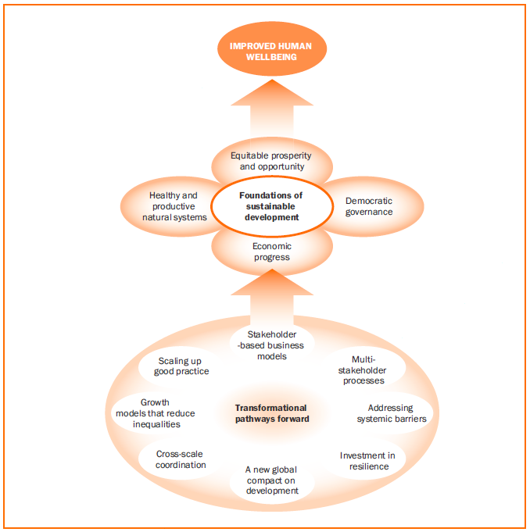
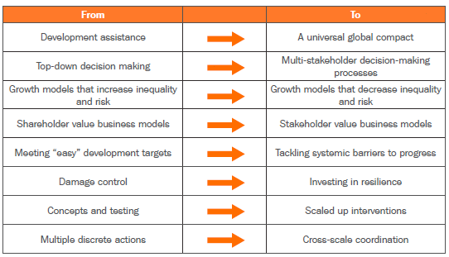
Transformational Pathways forward
Bringing together stakeholders and knowledge for informed, participatory governance

Slide 8
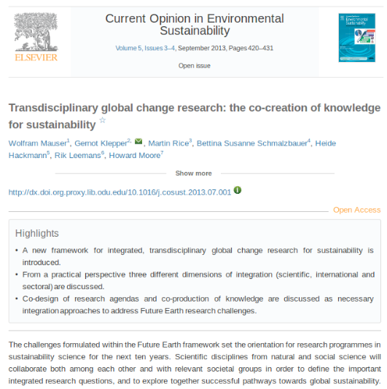
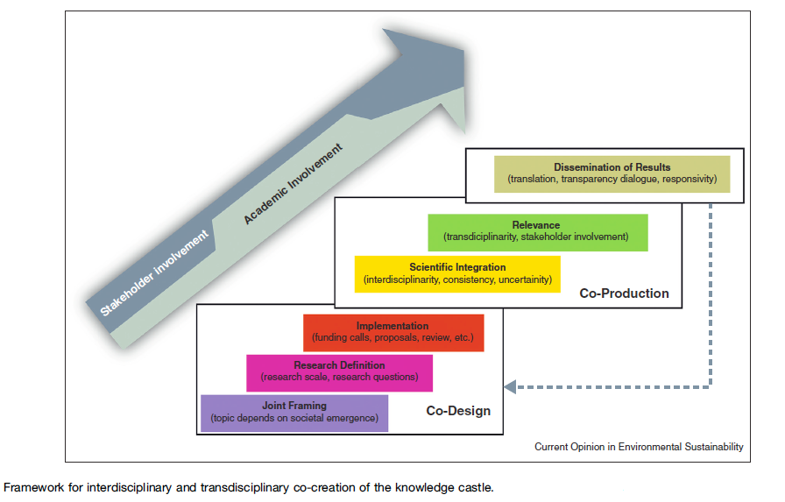
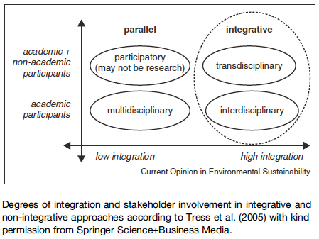
Co-design, co-creation, co-usage of knowledge

Slide 10
Social
Science
Society
Private
GEOSS Information System of Systems (GEOISS)
Public
Governance
Deliberations
Decision making
Participation
World
VST
Meetings
Deliberations
Risk-based choices
Scenarios
Visualizations
CoI mediations
Stakeholder
values &
interests
Instrument
Sensors
SD
Knowledge Creation and Usage:
- Co-design
- Co-creation
- Co-usage
(RIO+20)
LKB
Model Web
Services
GeoDesign
GIS
Integrated
databases
(environmental,
economic,
human)
ontology
What If?
Policies
Planning
Codes
Best &
next practices
Perceptions
Human
Sensors
Impacts
IoT
State
&
Trends
IoM
Predictions
Collaborative Platform for Cooperation

Slide 11
… on building information systems under a rapid technological development ...
Whatever is decided today is out-of-date by the time it is designed, tested, and implemented! Alan Edwards, 2012
The design of … of the future must be very flexible and highly adaptive
Challenge: Developing today the concepts for the technology of tomorrow!
Question: What are basic characteristics of bidirectional information systems based on tomorrow's technology?
facilitate co-design, co-creation, co-usage,
globally available and accessible;
developed by communities using it (open source, collaborative, “happiness” engineers);
processing resources (for knowledge creation) where the data sources are;
scalable;
collaborative development of best and next practices and workflows (open knowledge);
access to base datasets;
updated with low latency/in real-time by providers and users;
information density and quality increased through crowd sourcing and citizen scientists.

Slide 12

Global Coastal Zone Information System
Recovery
- revised hazard maps
- informed land use planning
- risk-based, post-event planning
Contents
& Functions
Preparedness
- hazard maps
- past hazards and disasters
- vulnerabilities and assets
- hazard monitoring
GCZIS
- globally available and accessible
- scalable
- cloud hosting and computing
- multi-media accessible
- best and next practices
- crowd sourcing
- GIS, web-based, interactive
- Tools
- visualizations
Response
- rapid disaster assessments
- crowd sourcing
- guidance for response teams
- response planning
Early Warning
- early detection
- time-variable risks
- warnings to authorities
- public information system

Slide 13
Global Coastal Zone Information System
Community Planning
- land use planning
- awareness, risk perception
- preparedness, resilience
- response planning
Communities
GEOSS/EOs
- hazard monitoring
- space-borne datasets
- in situ data
GCZIS
- responding to user needs
- developed together with communities
- knowing the user requirements:
GEOSS User Requirement Registry
- Virtual Stakeholder Table
- Deliberative Coastal Governance
GGIS-DRR
Crowd (sourcing)
- improvement of datasets
- densification of data
- rapid data updates
Expert knowledge
- best and next practices
- work flows
- interpretation of data

Slide 14
PARTICIPATION:
- Task Team of SB-01 and CZCP;
- GEO Participating Organizations (POs);
- international and national agencies;
- non-governmental organizations;
- links to national and regional agencies through Member Countries of GEO;
- International Coastal Atlas Networks (ICAN);
- private industry (Esri, ...)
ADDITIONAL IMPACTS:
- equal opportunity: urban and rural; developed and developing;
- support focus on most relevant hazards;
- change risk perception;
- support improved decision making to access to information, intelligence;
- standardization, interoperability, data sharing
IMPLEMENTATION:
- provision of key resources through developed countries;
- web-based access provides global availability;
- scalable;
- community support (from state/national agencies, research groups, study cases)
- makes best/next practices available to others
POPULATING THROUGH STUDY CASES, E.G.:
- Hampton Roads
- Caribbean
- West Africa
- ...

Slide 15
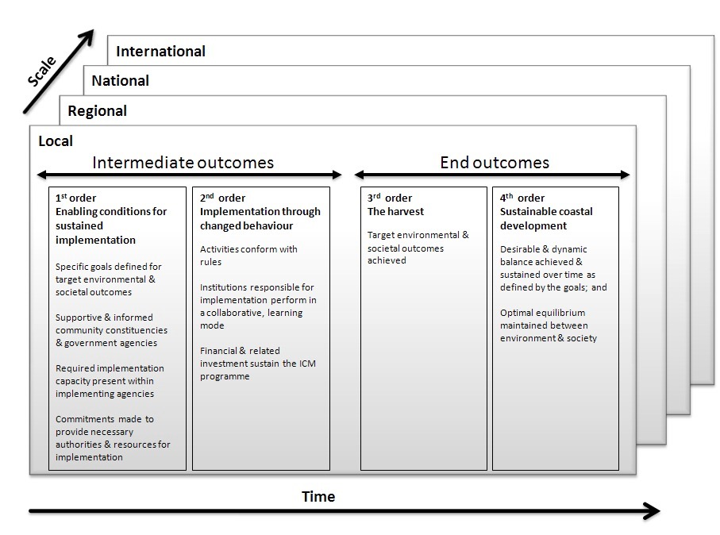
Deliberative Coastal Governance
Glavovic, 2013

Slide 16
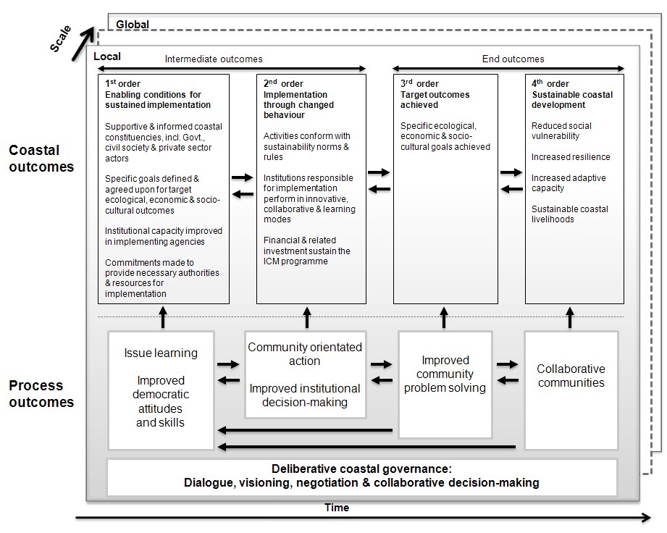
Deliberative Coastal Governance
Glavovic, 2013

Slide 17
Global Coastal Zone Information System
Can we use this to bring many of the on-going activities and stakeholders together?
Can we combine this with other Information Systems to build an Information System of Systems?

