Slide 1
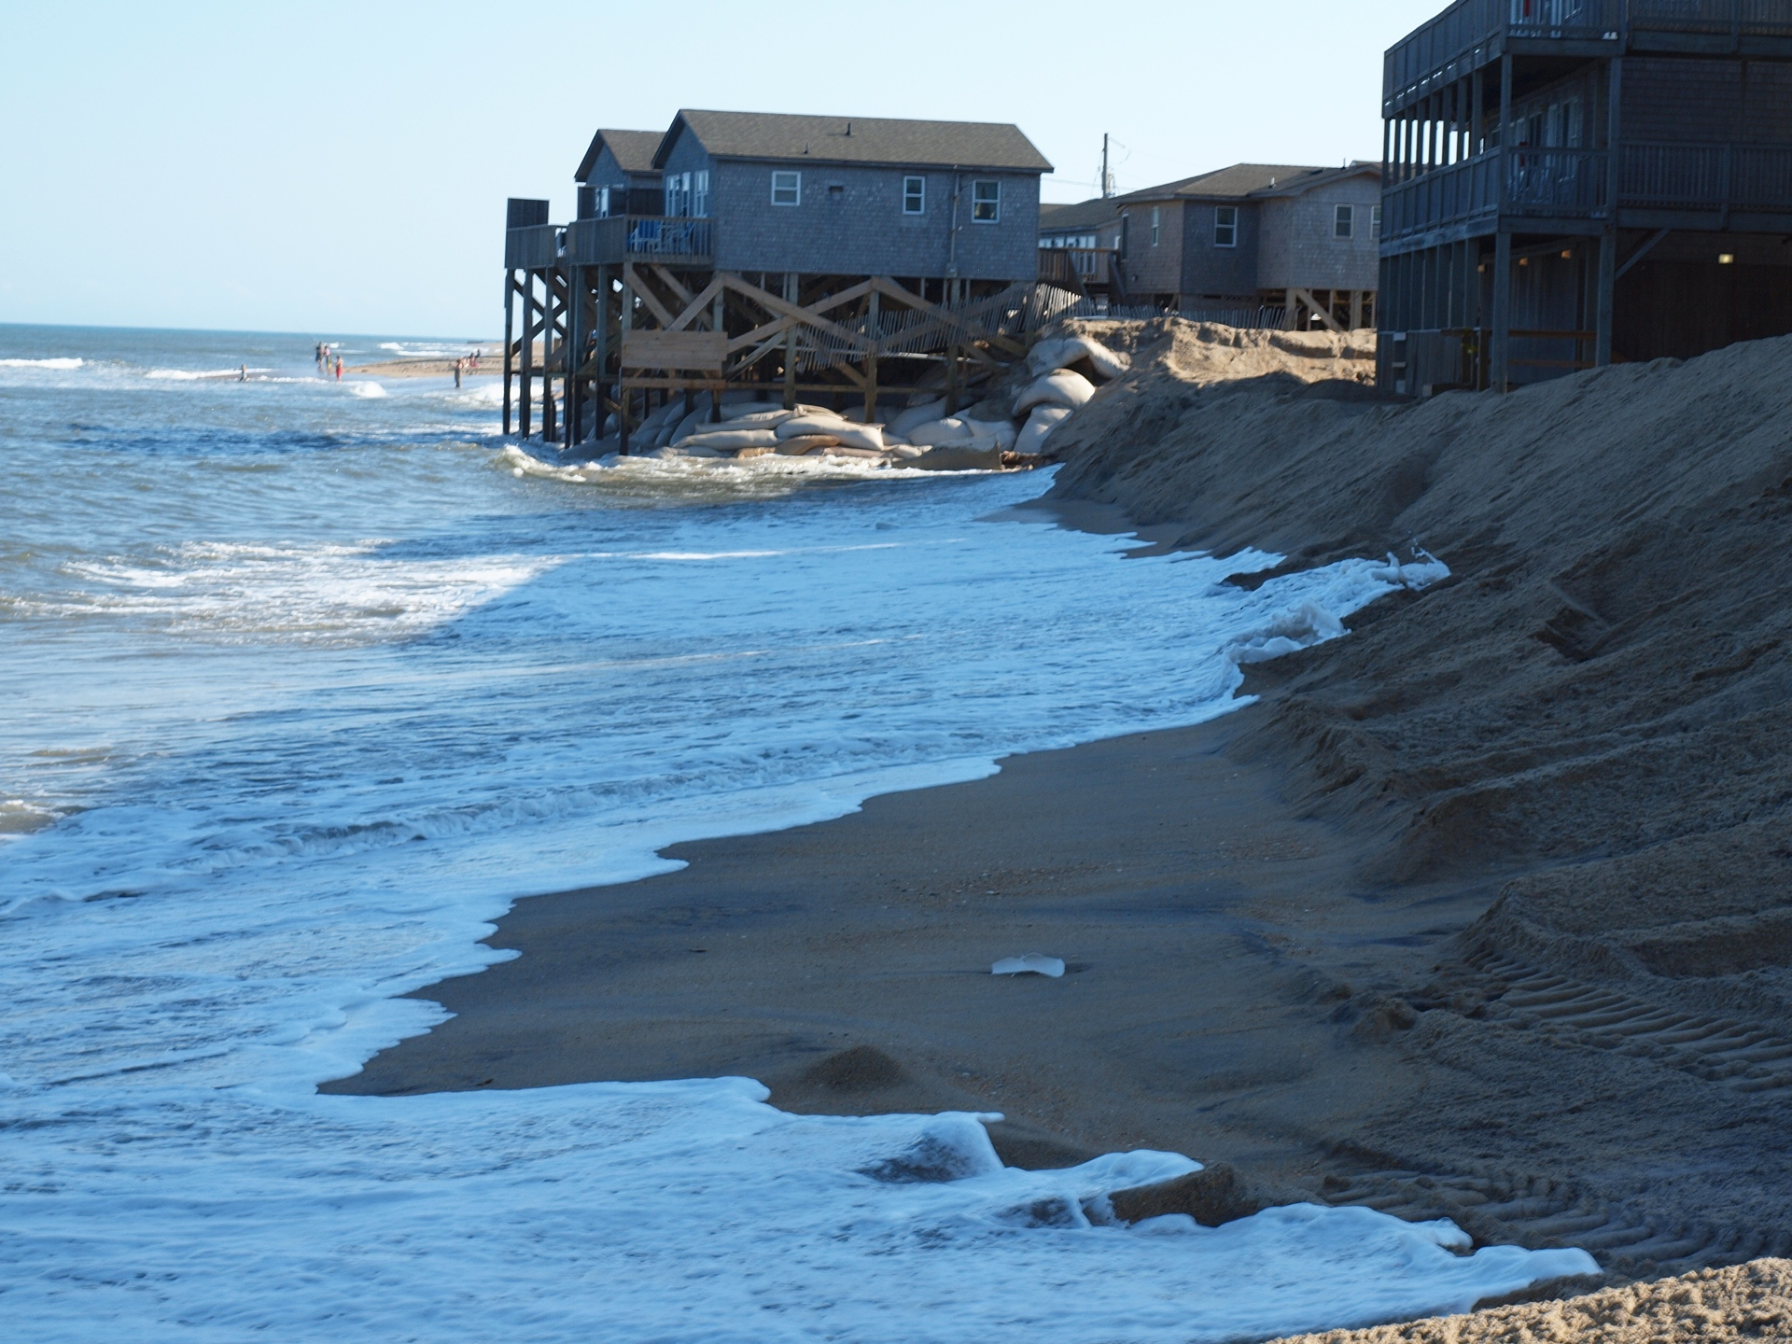
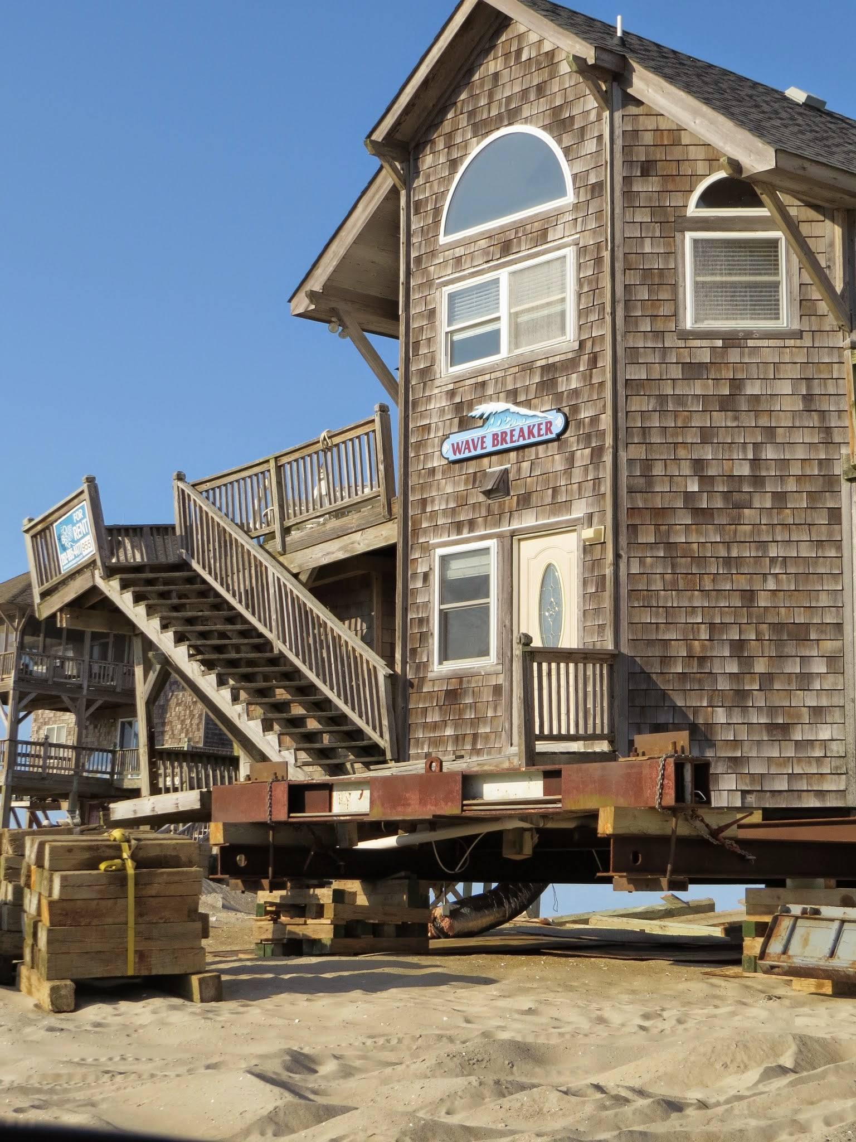
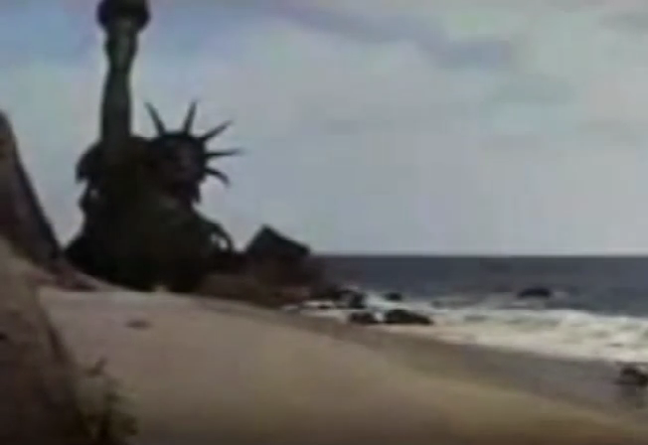
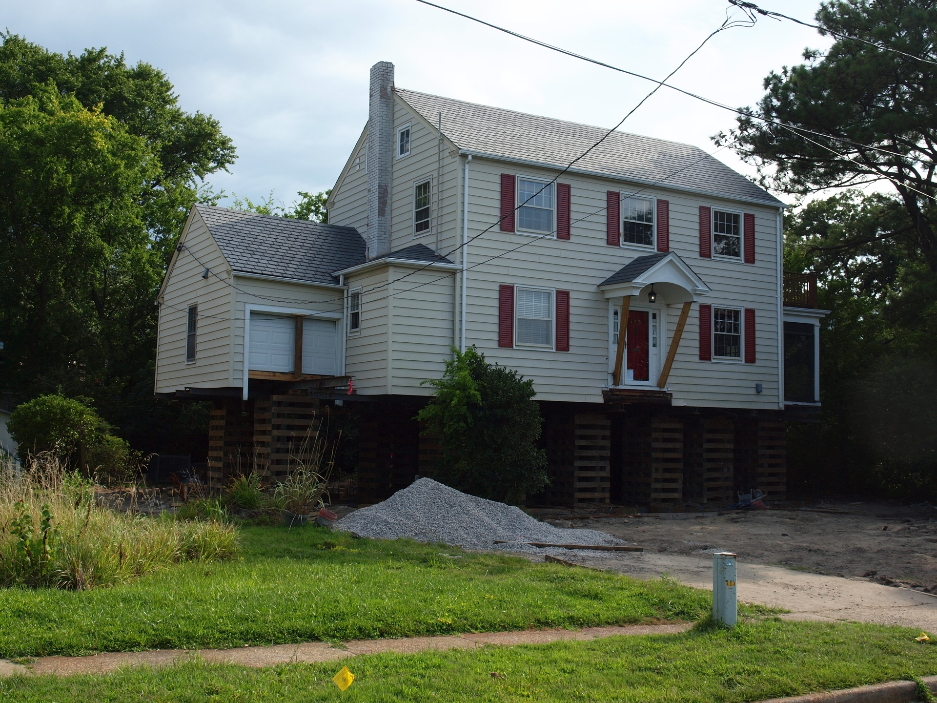
Why (LSL) Forecasting is Urgently Needed: Preparing for Surprises
Brief History
Approach
“Lifestyle Changes”
Hans-Peter Plag
May 28, 2015

Slide 2
When science facilitated industrialization, and access to seemingly unlimited energy sustained an extreme population growth, humanity developed a “life style” that resulted in a “reengineering" of the planet …
Humanity produces today more nitrogen than all bacteria on the planet, move more surface mass than all rivers together
Many Warnings:
Thomas R Malthus: Population growth will eventually outrun food production …
Albert A Bartlett: “The greatest shortcoming on the human race is our inability to understand the exponential function.”
Geoffrey West: We need innovations at an increasing rate to offset impacts of growth
Sir David Attenborough: “You can’t put infinity into something that is finite”
(Most of) science: technology and innovations can outrun impacts of growth …
Mantra of modern society: We need more growth … (and propel more inequality)

Slide 3
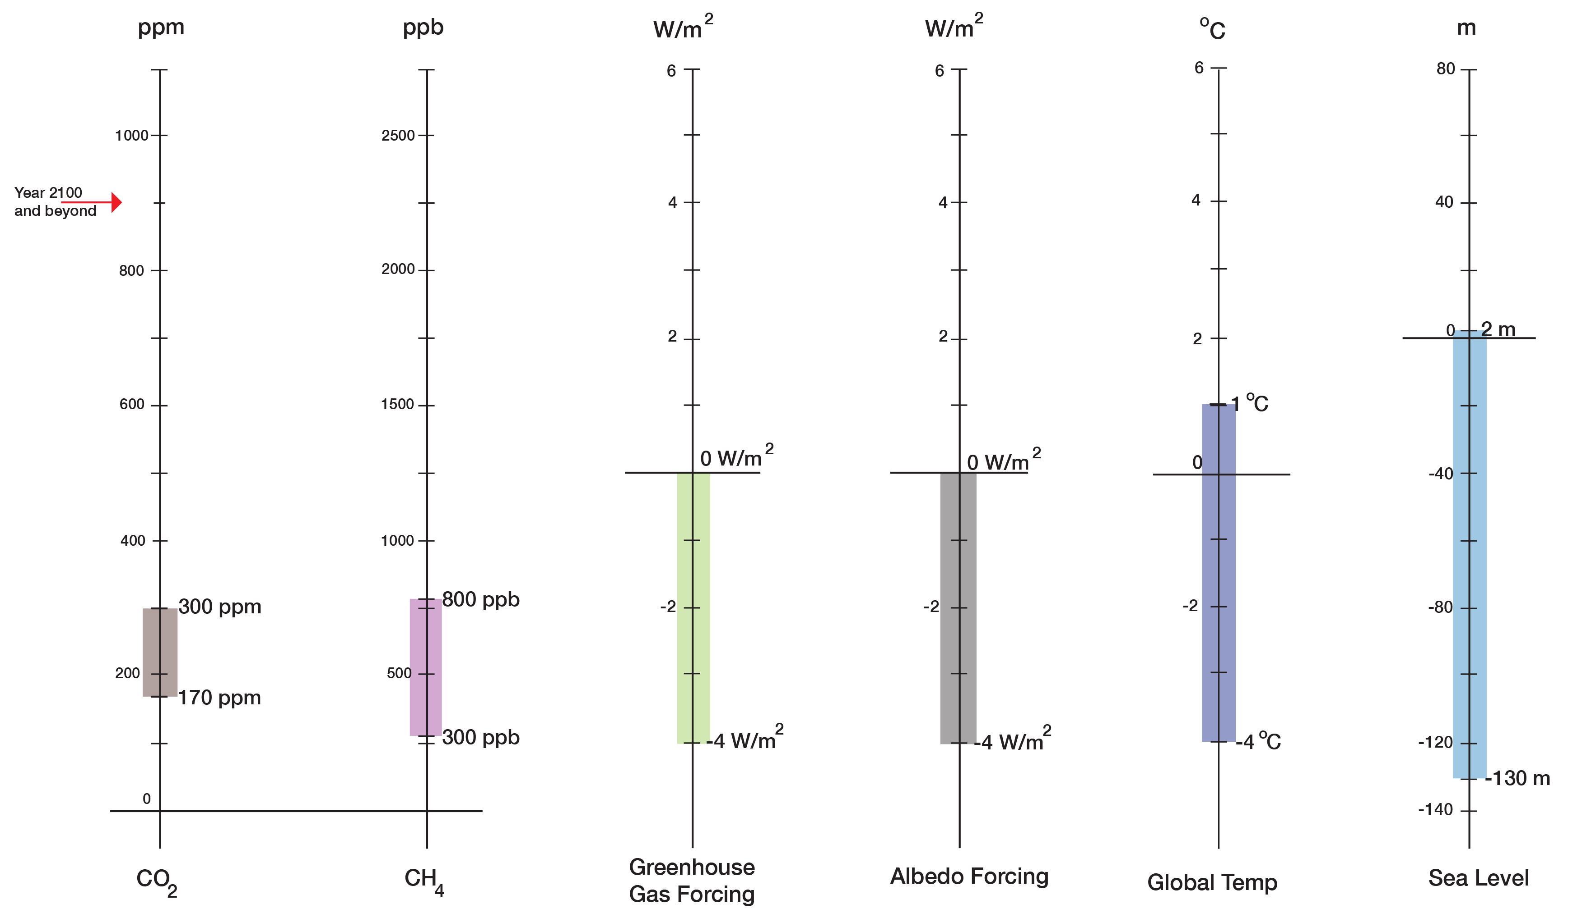
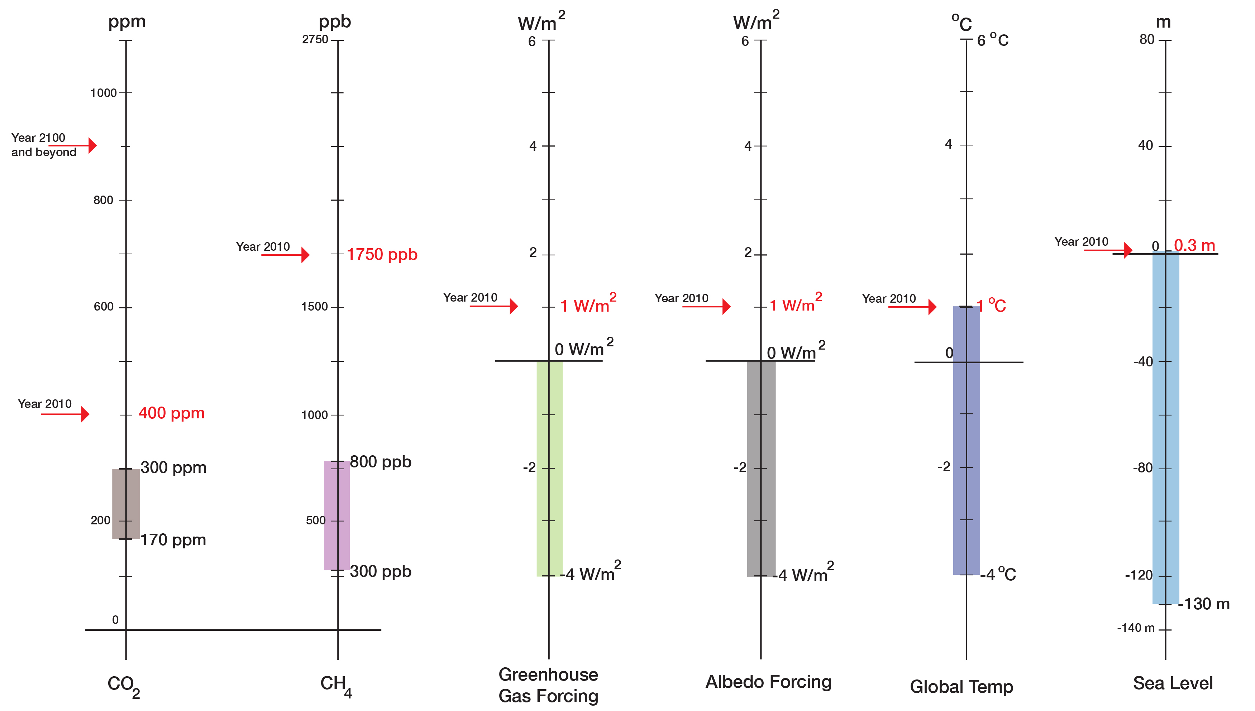
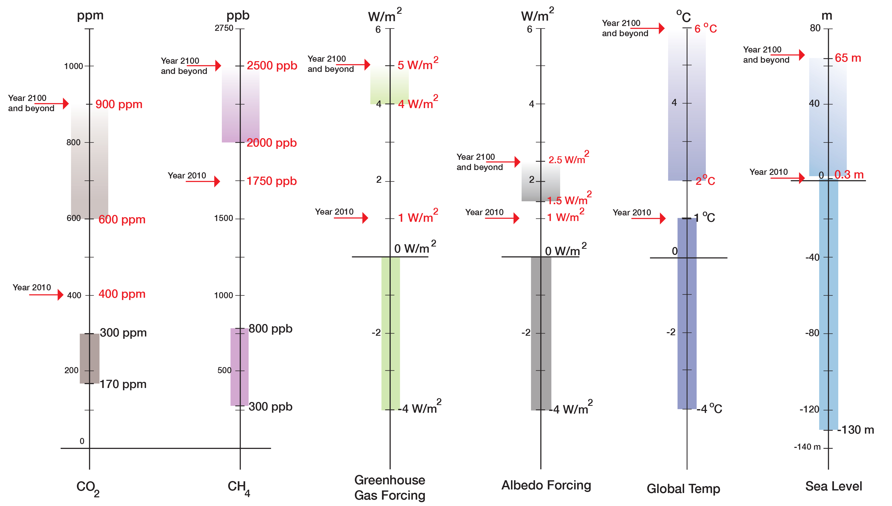
Long-term (centuries to millennia) correlations:
130 ppm CO2 <=> 5ºC
130 ppm CO2 <=> 130 m in sea level
“Prognosis”
“Current State”
“Normal Range”
(800,000 years)

Slide 4
We are not in the Anthropocene;
we are in the Anthroposition:
the transition from the Holocene to the Post-Holocene
Holocene: Last geological epoch that started 11,700 years ago
Stable climate and, in the later part, stable sea level allowed the development of civilizations
Humanity is in the “Emergency Room”
Holocene
20th and 21st Century
Future

Slide 5
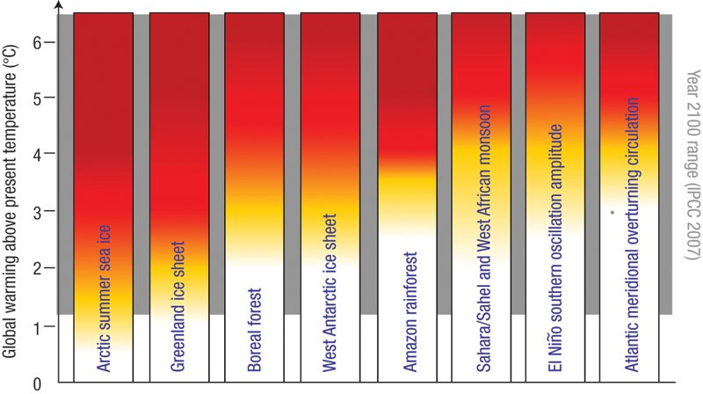
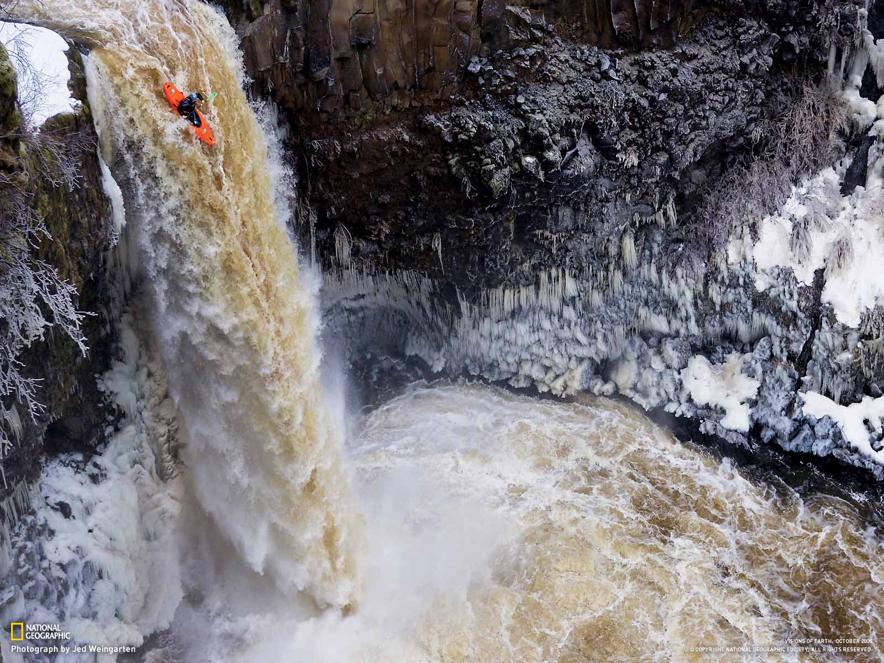
Crossing thresholds in the Anthroposition:
The threshold is not where the boat goes over the edge, it is far up the river, when the people in the boat lose the option to get to the shore
Tim Lenton
On a big, unknown river, don’t go into the middle, stay close to the shore
Jim White
Many thresholds, including climate change related ones …
Lenton & Schellnhuber (2007) Nature Reports Climate Change

Slide 6
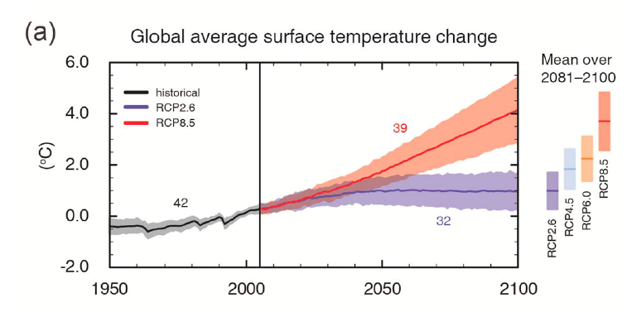
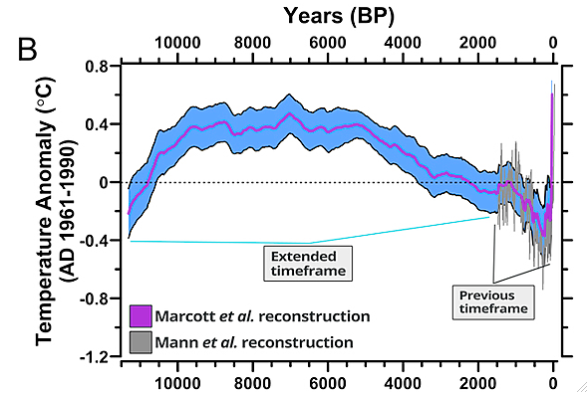
}
4
<--Post-Holocene
3
IPCC Assessment:
Very Likely by 2100
2
o
1 C
Science is not for fear mongering, but science must not overlook an emerging threat and danger and must enable timely warnings
<—————Holocene——————-—>
<--Holocene--->
The Holocene was a “safe operating space for humanity”
Rockström et al. (2009)
Marcott et al., 2013

Slide 7
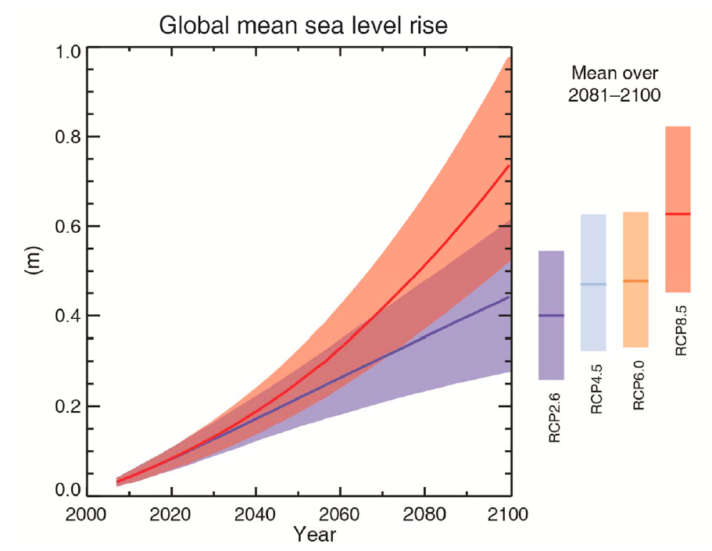
Note: No accelerated contribution from Greenland and Antarctic ice sheets consider
IPCC, 2013
Modified from Church et al. (2010)

Slide 8
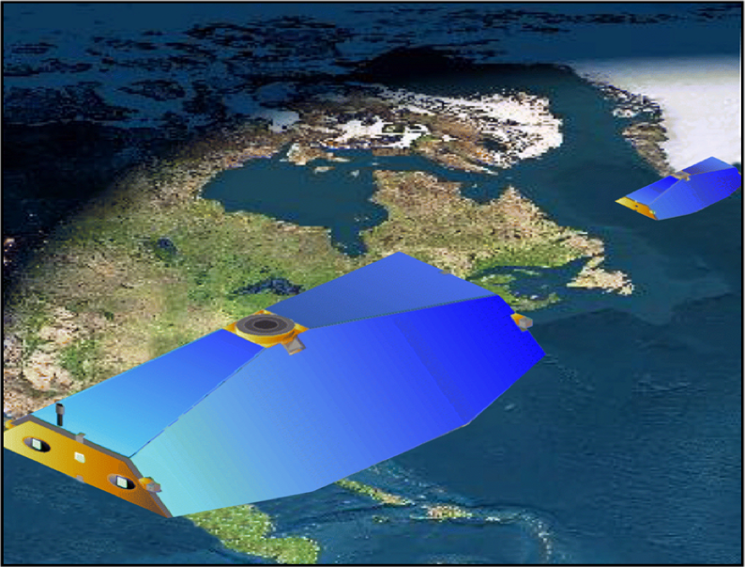
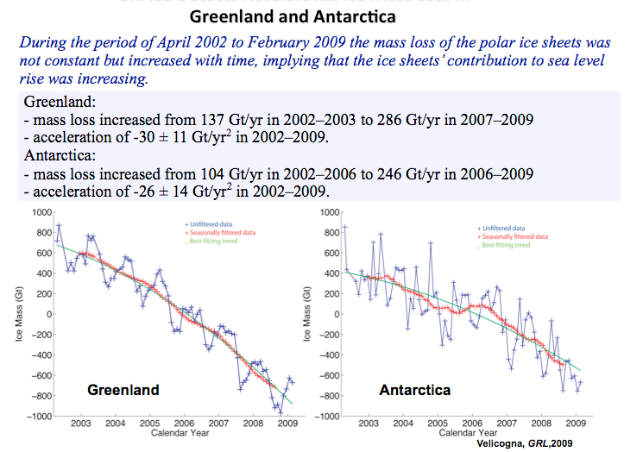
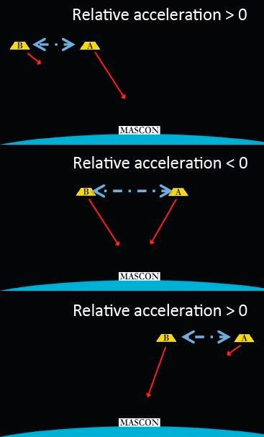
Example: Greenland and Antarctic Ice Sheets
Accepted knowledge in 2000:
Greenland: no significant contribution to sea level rise
Antarctica: minor contribution
Main contribution: steric changes
Gravity Recovery and Climate Experiment (GRACE)
The last 12 years of observing the ice sheets have revealed many surprises ...

Slide 9
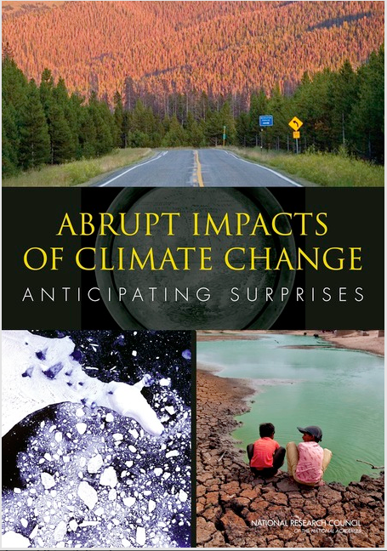
National Research Council in 2013:
There is the potential for surprises and new extremes ...
Already happening: Disappearance of late-summer Arctic sea ice
Already happening: Increases in extinction threats
Disruption of Atlantic Meridional Overturning Circulation: unlikely in the 21st century; but gradual chance could have severe consequences
Greenland ice sheet: abrupt changes very unlikely in the 21st century
West Antarctic Ice Sheet: up to 4.8 m sea level rise; abrupt changes unlikely in the 21st century
Most likely (low-probability) rapid impact: ocean acidification

Slide 10
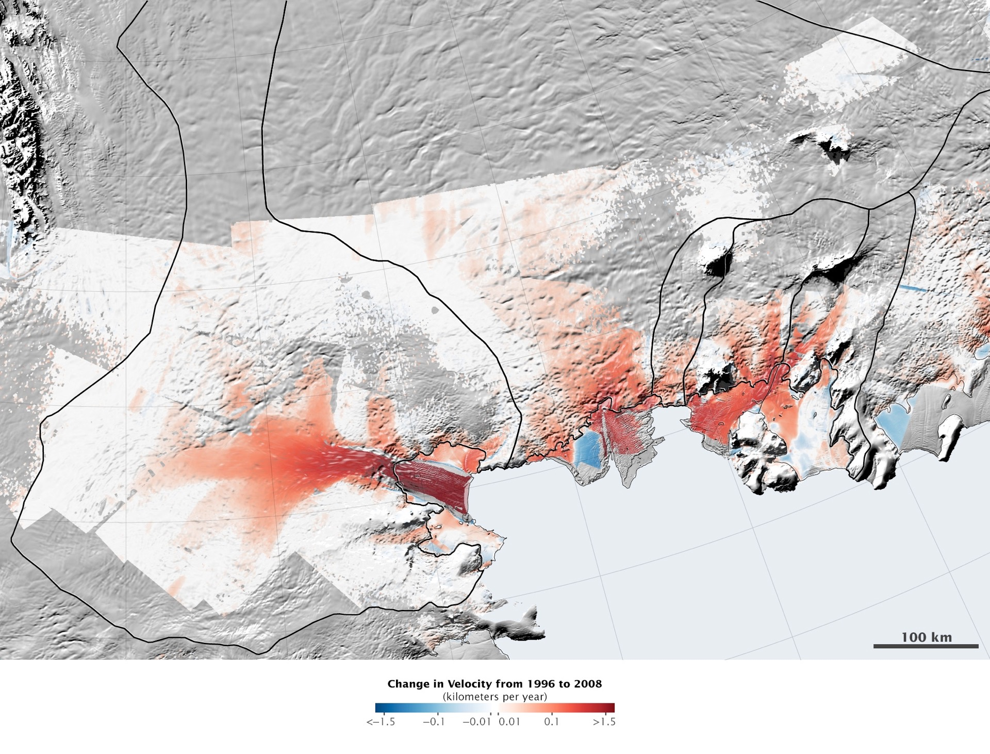
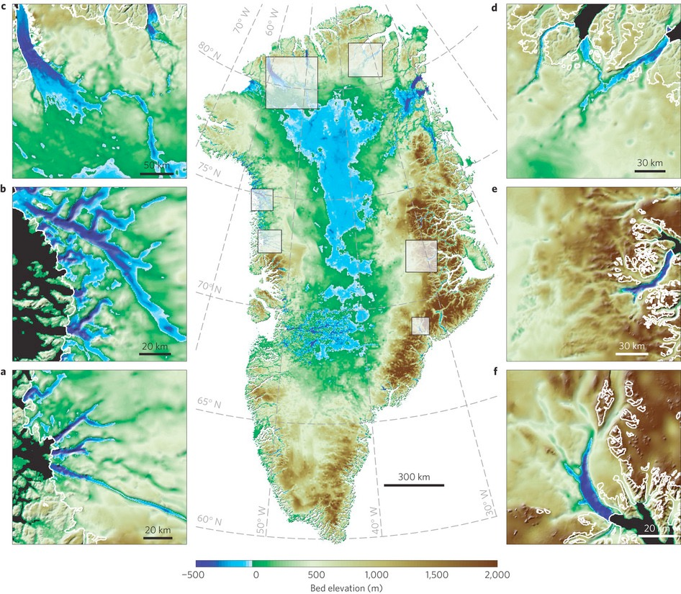
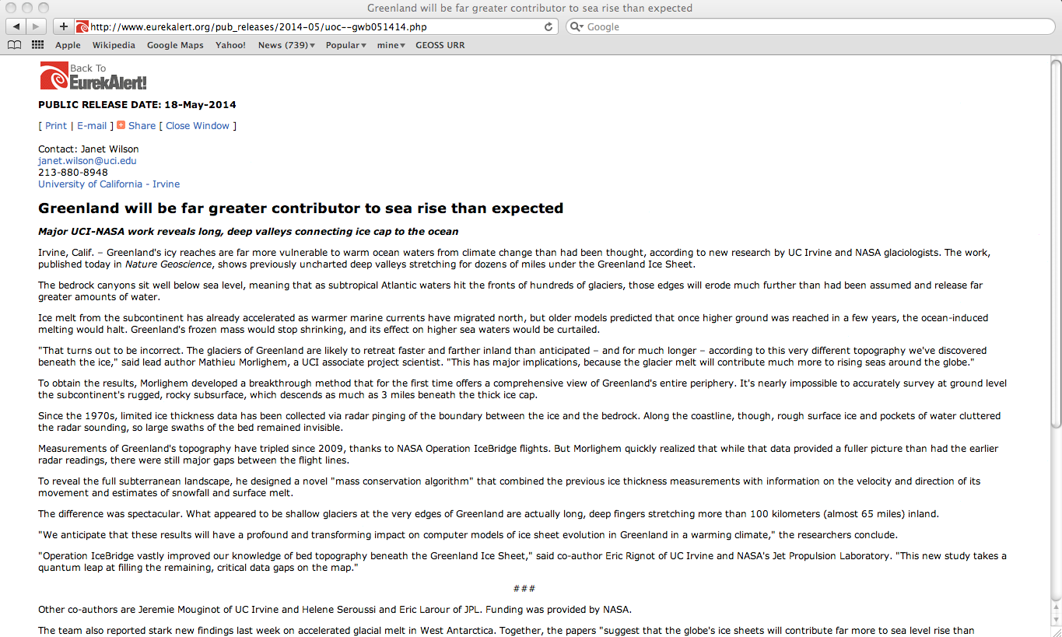
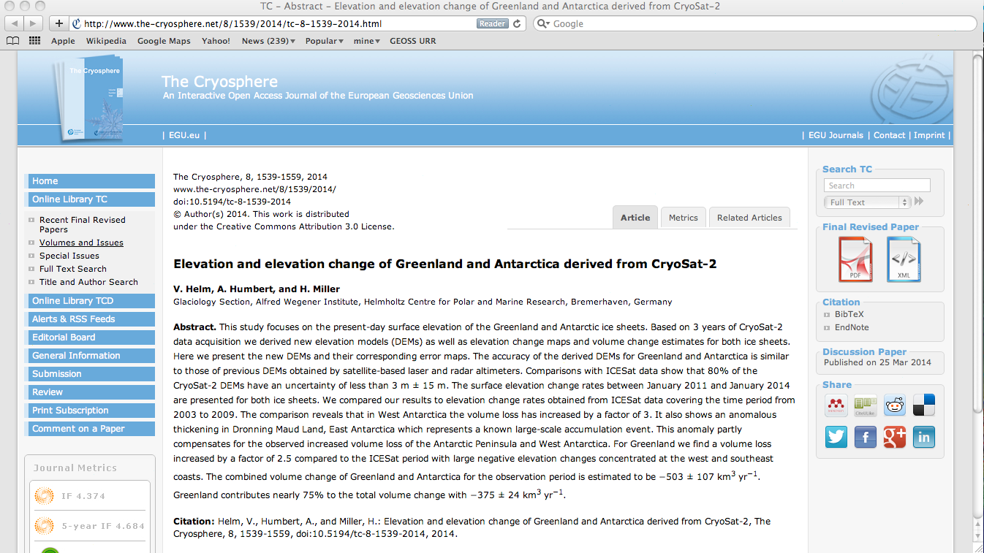
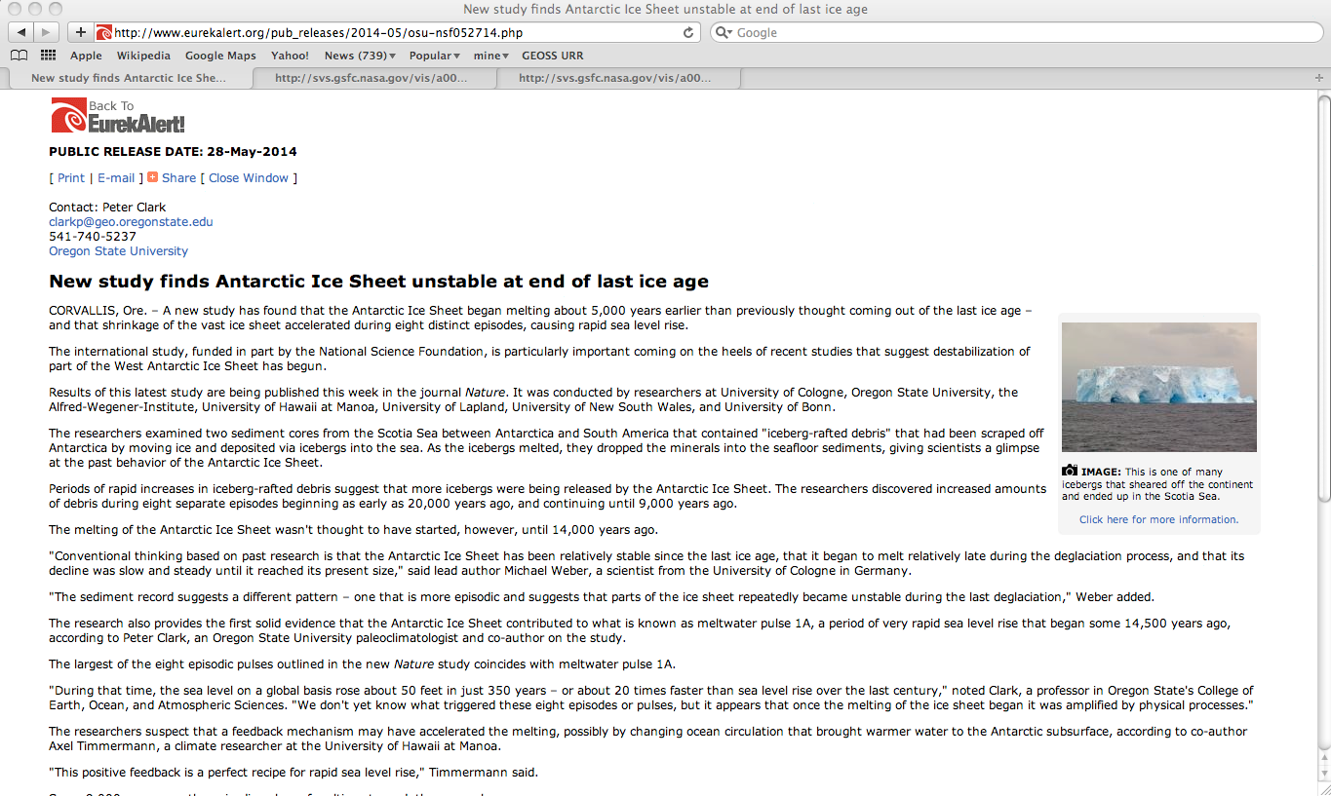
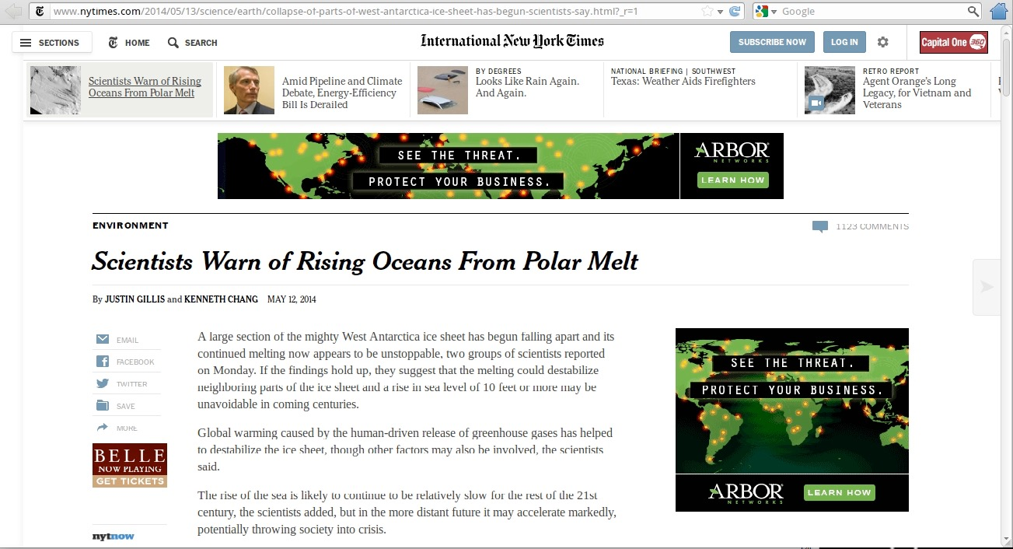
May 12, 2014: A large section of the mighty West Antarctic ice sheet has begun falling apart ... That’s enough ice to raise global sea level by more than 15 ft. (4.6 m)
National Research Council in 2013:
There is the potential for surprises and new extremes ...
May 18, 2014: The glaciers of Greenland are likely to retreat faster and further inland than anticipated ....
September, 2014: The combined volume change of Greenland and Antarctica for the observation period is estimated to be −503 ± 107 km³ yr⁻¹. Greenland contributes nearly 75% to the total volume change with −375 ± 24 km³ yr⁻¹
May 28, 2014: During that time, the sea level on a global basis rose about 50 feet in just 350 years

Slide 11
WAIS Contribution to Global Sea Level
Accepted knowledge in 2000:
Greenland: no significant contribution to sea level rise
Antarctica: minor contribution
Main contribution: steric changes
4.5 m
Knowledge in 2014:
Greenland: is contributing, is accelerating, potentially a large contribution to sea level rise
Antarctica: West Antarctic ice sheet (WAIS) will contribute 4.5 m
800 Years?
100 Years?
How worried should we be?

Slide 12
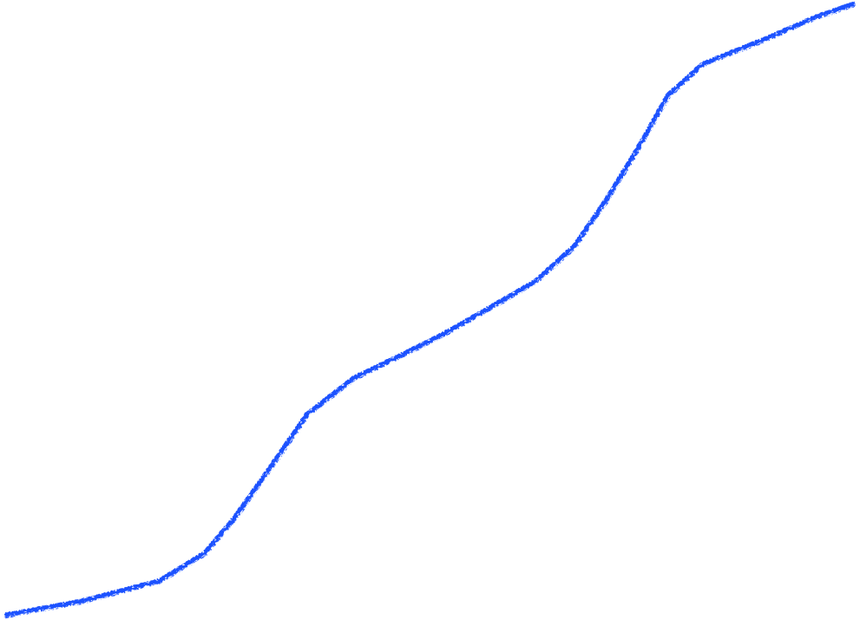
We need EWS for LSL
Modified from Church et al. (2010)

Slide 13
Need of having an EWS: Interannual to decadal LSL Forecasting
- based on requests from city managers and other stakeholders;
- Plag et al. (2010); Plag (2014)
- NRC (2013): Abrupt changes are under way:
There is a need for an Abrupt Climate change EWS (ACEWS);
- Showstack (2013): ACEWS

Slide 14
Towards a decadal local sea level prediction service
Numerical Weather Prediction
1904 first proposed
1922 detailed
1950 first performed
1958 became useful
1970 became good
now global infrastructure
Decadal sea level forecasting
2009 first proposed
2010 detailed
2015 first performed
2018 becomes useful
2022 becomes good
2025 global infrastructure

Slide 15
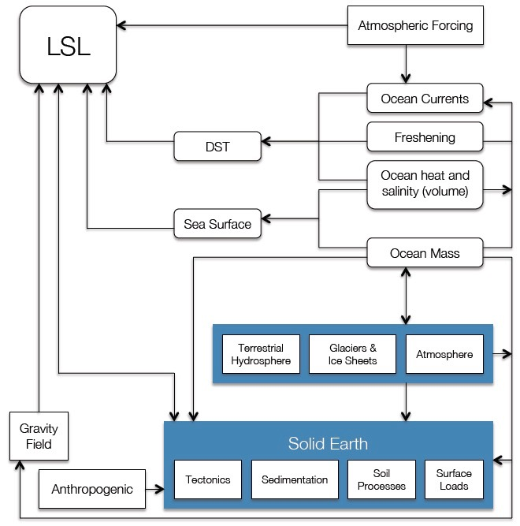
LSL is the output of Earth system processes
There is no earth system model that can predict LSL ...

Slide 16
LSL = short-period part (up to 2 months) + long-period part
Short-period variations are the result of local to regional processes

Slide 17
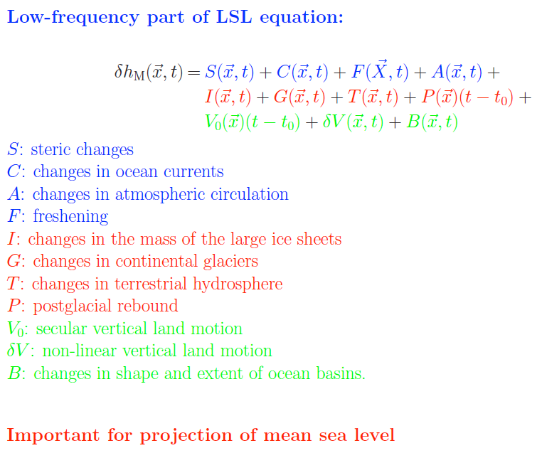
Long-period variations are the result of local to global processes

Slide 18
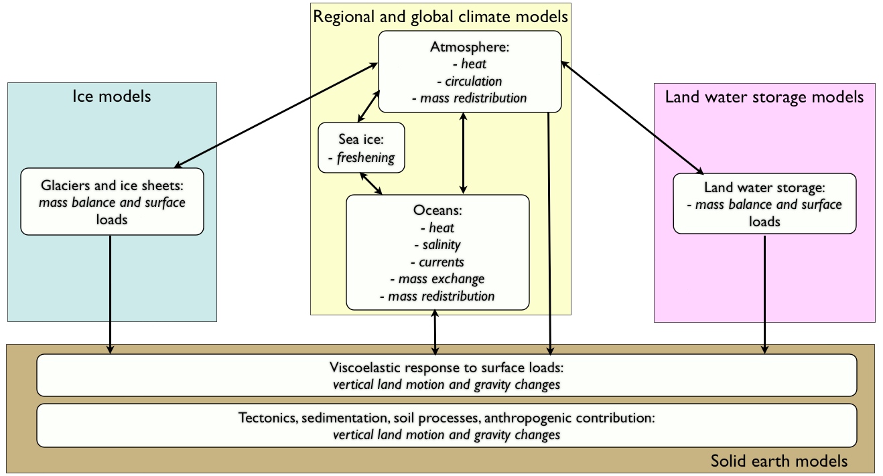
Postglacial rebound: mean model plus uncertainties (linear)
Present-day mass movement: geophysical (elastic) model plus observation/predictions of mass redistribution (land ice and land water storage)
mass redistribution:
- Land water storage: GLDAS + GRACE
- Ice sheets: GRACE, satellite altimetry, models
- Glaciers: extrapolation of observed trends Vertical land motion: observations, extrapolation of recent trends
Atmospheric and ocean circulation: GCMs, regional models, and observations
Steric effects: ARGOS and other observations
Freshening: remote sensing and models
Constraints/assimilation:
- Global (water) mass balance
- Tide gauges and satellite altimetry
- Earth rotation observations
Forecasting of Local Sea Level (LSL)
We need a community effort to develop, validate and operate the LSL forecasting system

Slide 19
Current paradigm:
“Sea level does not change very much, coastal zones change slowly, and the potential for surprises is low.”
New paradigm:
“Sea level may change rapidly and coastal zones may migrate very fast.”
Consequence:
be prepared to leave
keep the coastal zone clean and prepared for inundation
have early warning systems in place
Decision Making Under Uncertainty (DMUU) ——> Decision Making Under Foreseeability (DMUF)

