Slide 1
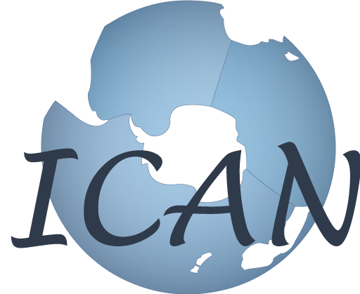
ICAN – Global Expertise in Coastal Atlases
Marcia Berman
Virginia Institute of Marine Science,
College of William and Mary
USA
Ned Dwyer
Coastal & Marine Research Centre,
University College Cork, Ireland
CZCP Core Group Meeting 27-28 August 2013

Slide 2
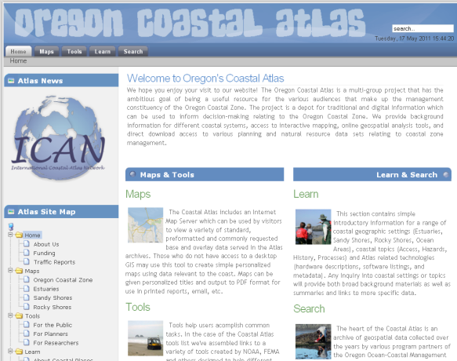
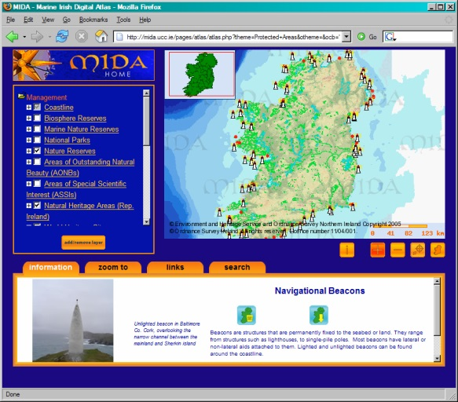
ICAN in a Nutshell
The aim is to be a global reference for the development of coastal/marine web atlases (CWAs).
It intends to lead, influence, guide and inform in a coherent manner on matters related to development and use of coastal/marine web atlases
Notes:
The idea here is that the audience should know from the outset what the focus of ICAN is

Slide 3
What is a Coastal Web Atlas?
“A collection of digital maps and datasets with supplementary tables, illustrations, and information that systematically illustrate the coast, oftentimes with cartographic and decision support tools, all of which are accessible via the Internet.”
(O’Dea et al., 2007)

Slide 4
Goals of ICAN
Ensure network has wide representation (developers/users)
Develop technical & policy guidelines for atlas developers
Highlight benefits of interoperability & standards based systems
Notes:
Highlighted in bold are the key elements ICAN focussed on. You can talk briefly around these points

Slide 5
Goals of ICAN
Develop collaborative projects for sharing know-how, atlas implementation and demonstration
Align atlas efforts to facilitate interoperability
Engage with other relevant projects and developments
Involve representatives of the user communities

Slide 6
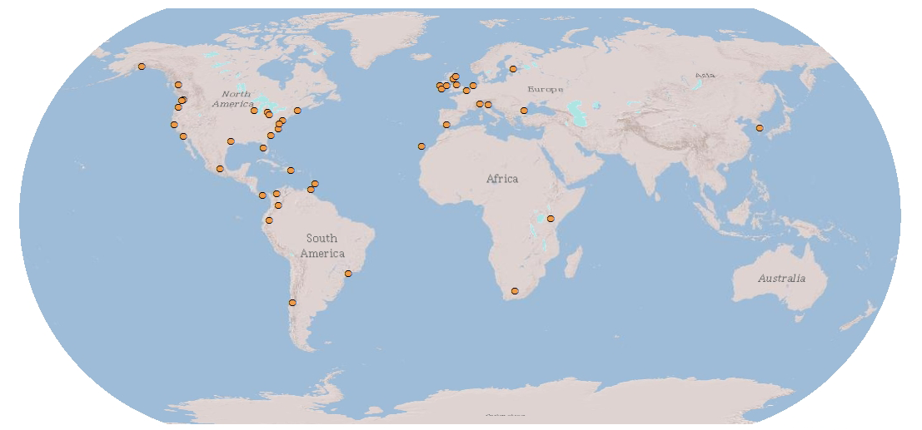
Current Membership: 60 organizations from 18+ nations and growing…
http://icoastalatlas.net/member_dir
Notes:
Membership is very good in the Americas, Europe and Africa. A bit sparse in Australiasia.

Slide 7
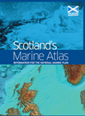
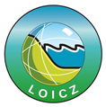
A Sampling of the 60+ Members
Alaska Coastal Mgmt
NOAA MMC
Notes:
ICAN currently involves over 60 institutions from 15 countries plus the UNESCO IODE (Intl Ocean Data/Information Exchange).
Members come form developed and developing countries and includes atlas efforts at local, national and regional scale

Slide 8
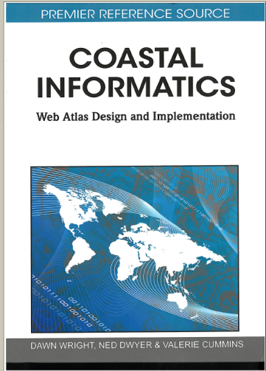
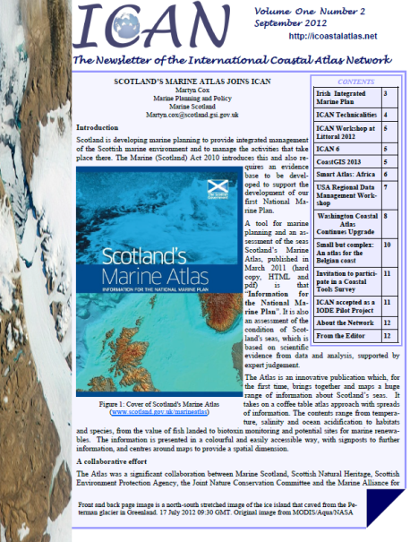
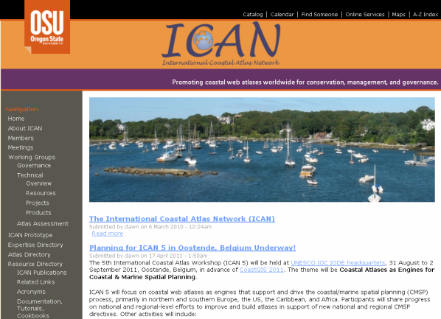
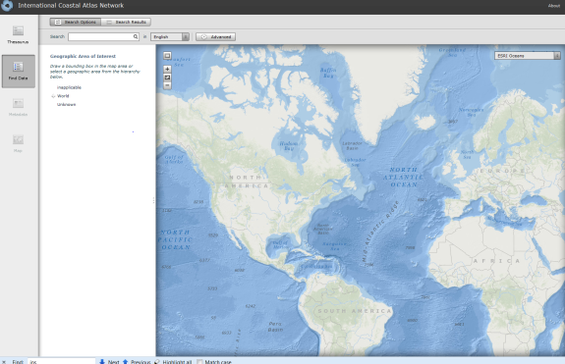
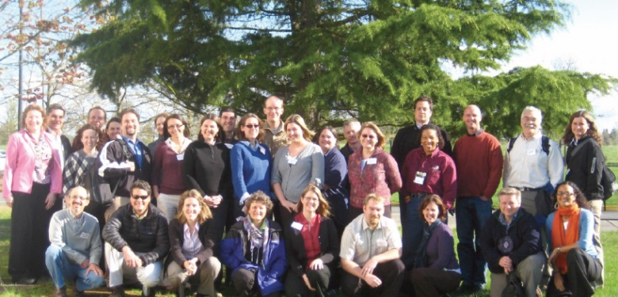
Some Recent Achievements
Notes:
This is just a topic heading – Details on subsequent slides

Slide 9
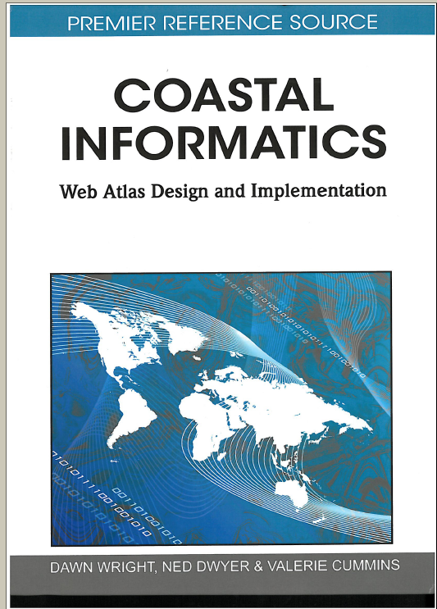
Guidelines for Developers
Principles of atlas design
Case Studies around the world
CWA Management and Governance issues
http://ican.science.oregonstate.edu/handbook

Slide 10
The ICAN Interoperability Portal
Connect individual coastal atlases to an integrated global atlas
Notes:
Via a unique portal, a user can search all atlases connected, and return a series of relevant metadata from these various atlases. The underlying data can then be viewed on the map. This demonstrated the potential for linking a series of regional atlases. A key requirement is that the underlying atlases are using OGC protocols and international metadata standards.

Slide 11
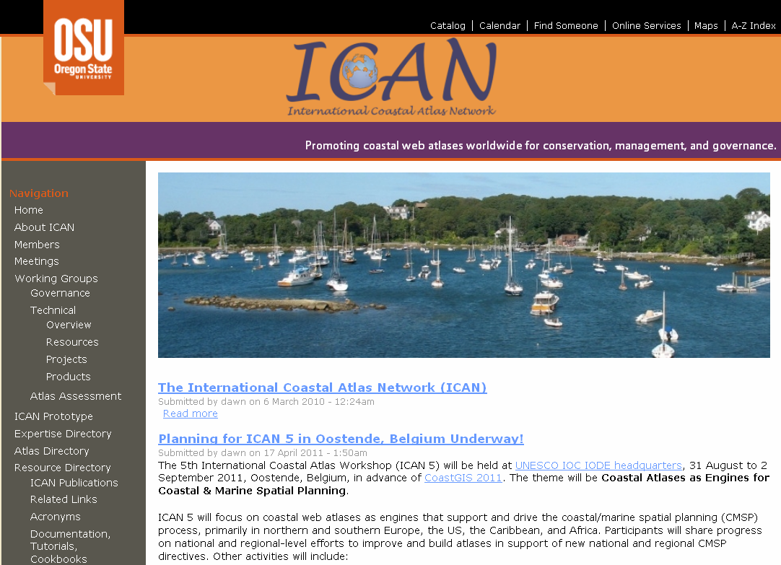
Internet Resources and Newsletters
ICAN Objectives
Members
Workshop reports
Publications
Handbook
Working Groups
Interoperability
portal
Newsletters
http://www.icoastalatlas.net

Slide 12
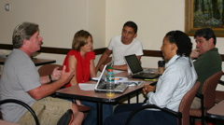
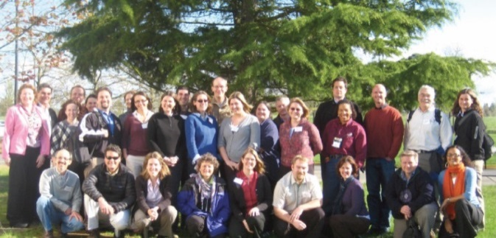
Training is a key ICAN activity
Ocean Data and Information Networks
- Africa
African Marine Atlas Workshops
- Latin America
Carribean Marine Atlas workshops
SPINCAM – Southeast Pacific
- United States
West Coast Coastal Atlas workshop
Great lakes Workshop 2010
Notes:
The Southeast Pacific data and Information Network

Slide 13
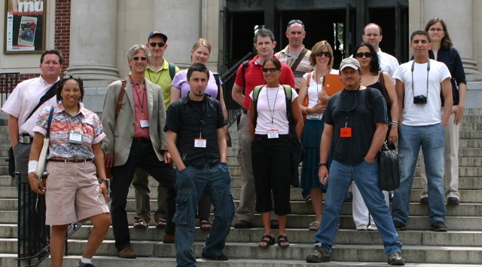
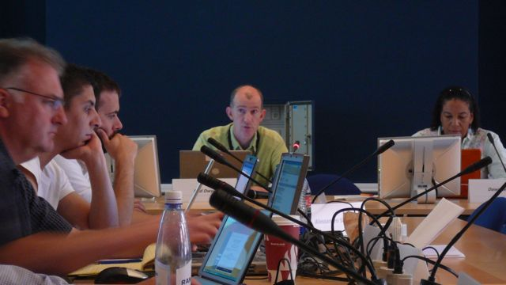
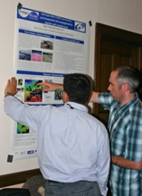
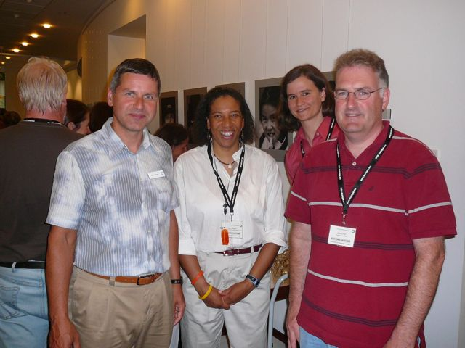
Member Workshops
Cork – 2006
Corvallis - 2007
Copenhagen - 2008
Trieste - 2009
Ostend -2011
Victoria – 2013
South Africa - 2015
Meetings section of ICAN web site

Slide 14
ICAN organisation and governance
Since March 2013 an IOC-IODE Project
Steering Group
Name | Affiliation
Ned Dwyer | CMRC, Ireland (chair)
Angora Aman | ODINAfrica, African Region
Kathy Belpaeme | Coordination Centre ICZM, Belgium
John Bemiasa | ODINAfrica, African Region
Marcia Berman | VIMS, USA
Alejandro Iglesias | IOC
Kathrin Kopke | CMRC, Ireland
Tony La Voi | NOAA, USA
Adam Leadbetter | BODC, UK
Roger Longhorn | EUCC, Belgium
Andrus Meiner | EEA, EU
Liz O Dea | State of Washington Dept. of Ecology, USA
Ramon Roach | Coastal Zone Management Unit Barbados (CMA), Caribbean Region
Lucy Scott | ASCLME, African Region
Andy Sherin | ACZICS, Canada
Dawn Wright | ESRI Chief Scientist, USA

Slide 15
Possible Collaboration with CZCP
Guidance and Resources for development of coastal information systems (NETMAR; Eionet; SeaDataNet);
Strong developer community can demonstrate latest technology approaches (technical work group)
Good experience in engaging with user communities
Training and capacity building
Data sharing and access – addressing technical and socio-political issues
Notes:
These are the points I mentioned in the email to you, coming out of Hans-Peter’s presentation in Victoria, so it is a starting point for discussions with the core group. Eionet: European Environmental Information and Observation network; Netmar: Network for Marine Environmental Data;

