Slide 1


Assimilation, Modeling & Forecasting:
Toward Ocean Products and Services in Africa
Dr Neville Sweijd (CSIR)
Manager: Coasts and Oceans Competence Area

Slide 2
Seasonal Climate
Forecasts & Applications
Operational
Oceanography
Climate Change
Projections
ACCESS Services
Outreach
Masters Programme
Bursaries
(M.Sc/PhD/Post-Doc)
ACCESS Education & Training
ACCESS Research
Biogeochemical Cycles
Climate variability & Change
Paleoclimates
Global Change & Socio-Economy

Slide 3
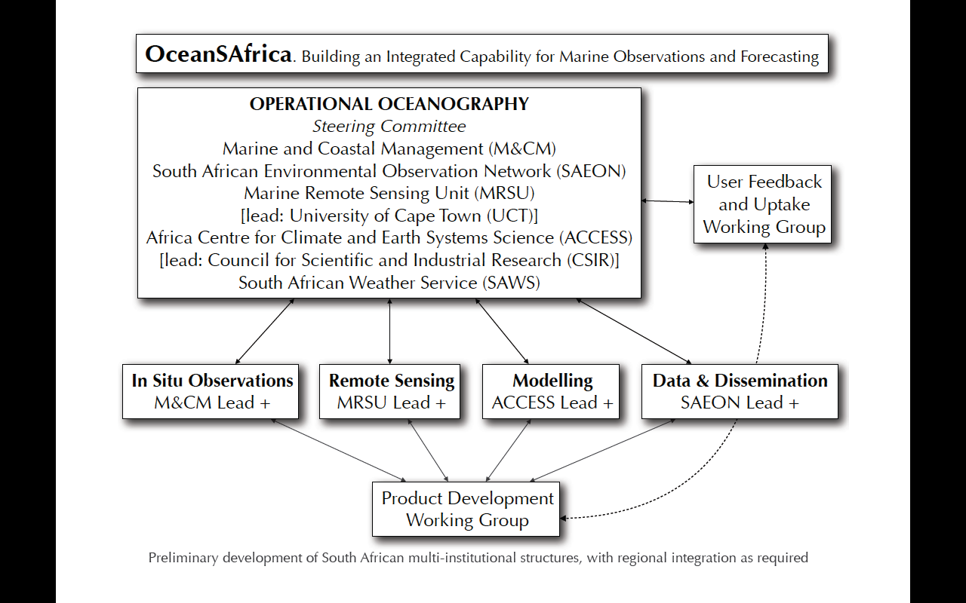
Operational Oceanography
Range of scales / questions and tools
Modelling:
ROMS / MOM – Bluelink
Boundary conditions/ coupling and assimilation
Small scale examples
Coastal management examples
Observations: PICO

Slide 4
Range of Scales / Questions & Tools
Delt3D
DHI
HRs / Days
Meters
MikeN
Seamless interoperability
MOM/ ROMS
Local scale issues:
e.g. Pipeline dispersal EIA /
Design of harbour wall
MOM/
ROMS
Scale
HYCOM
Bays & Bights - resolution of hydrodynamics
Weeks / Months
/ Decades
Km x 10³
Systems and LMEs
Resolution

Slide 5
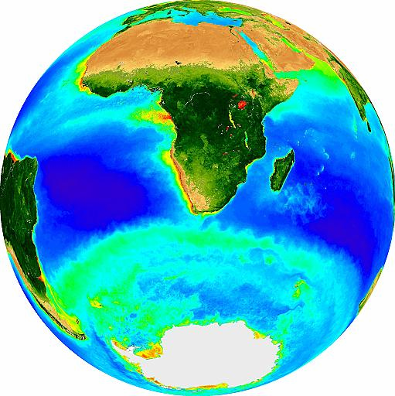
Range of regional domains

Slide 6
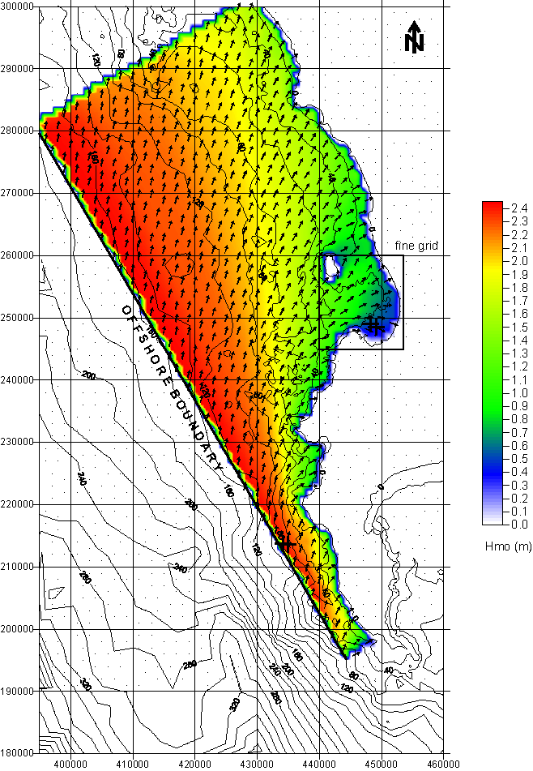
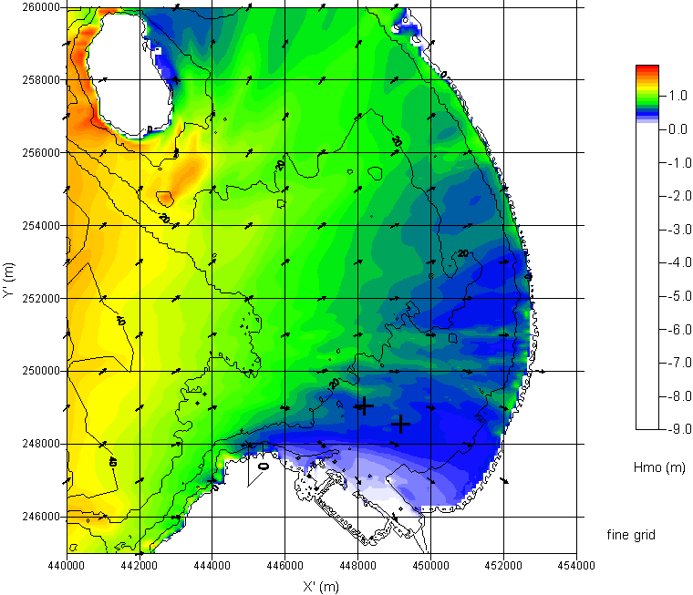
Realtime spatial systems: virtual buoys

Slide 7
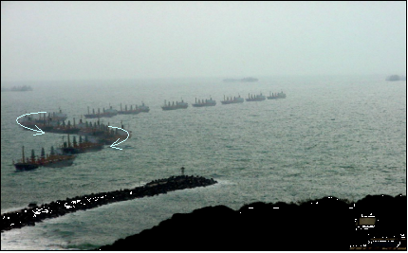
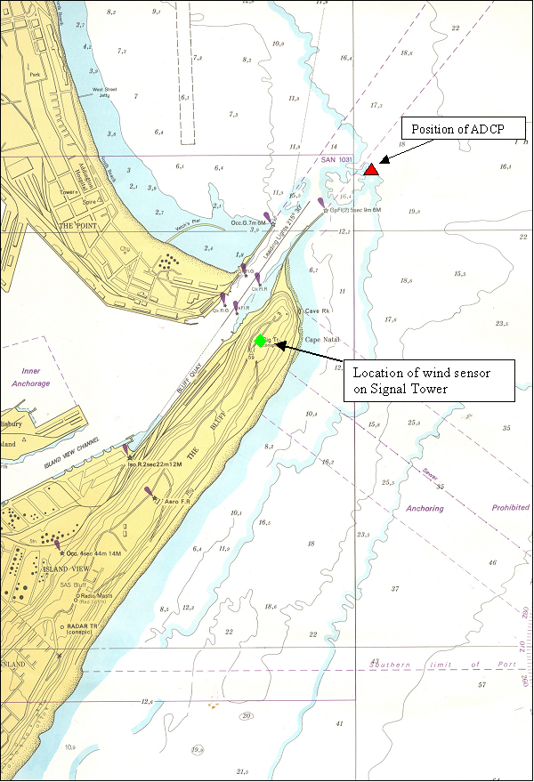
Realtime systems: Virtual ADCP Durban
Salinthip Naree
S Patel (2002) – Masters Thesis “Application of Digital Imaging in Measuring Cross Track Drift for vessels entering a Port”

Slide 8
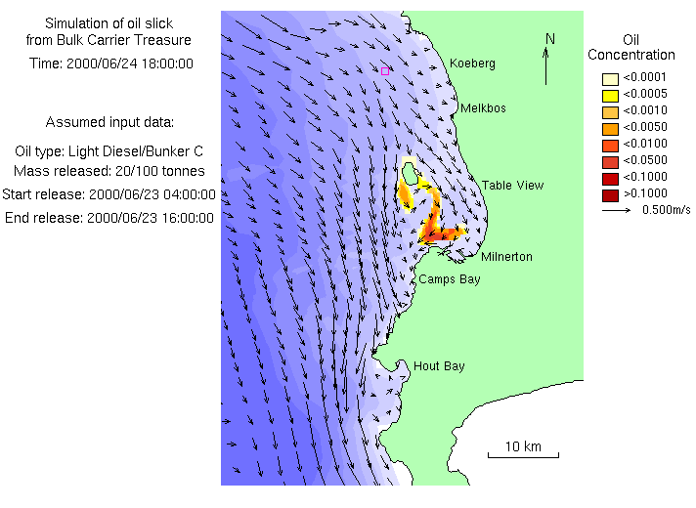
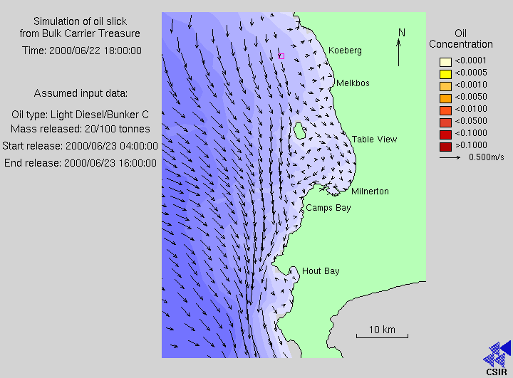
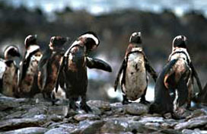
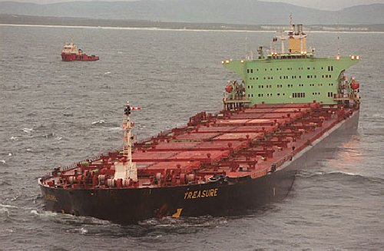
Nowcasts / Forecasts : Oilspills
Some of the 20,000 oiled African penguins on Robben Island before being captured. Photo: Jon Hrusa /IFAW
The MV Treasure sinking
(http://www.geoscience.org.za/bellville/penguin.htm)

Slide 9
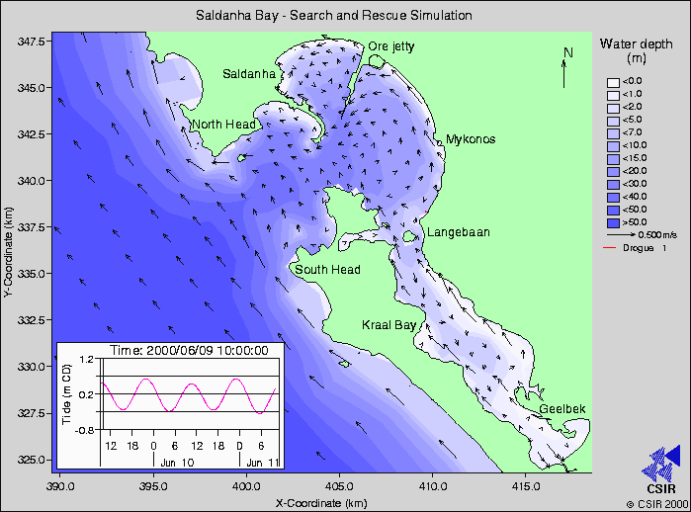
Nowcasts / Forecasts : Search & Rescue
CSIR WEB-based modelling site: http://coastalmodels.csir.co.za

Slide 10
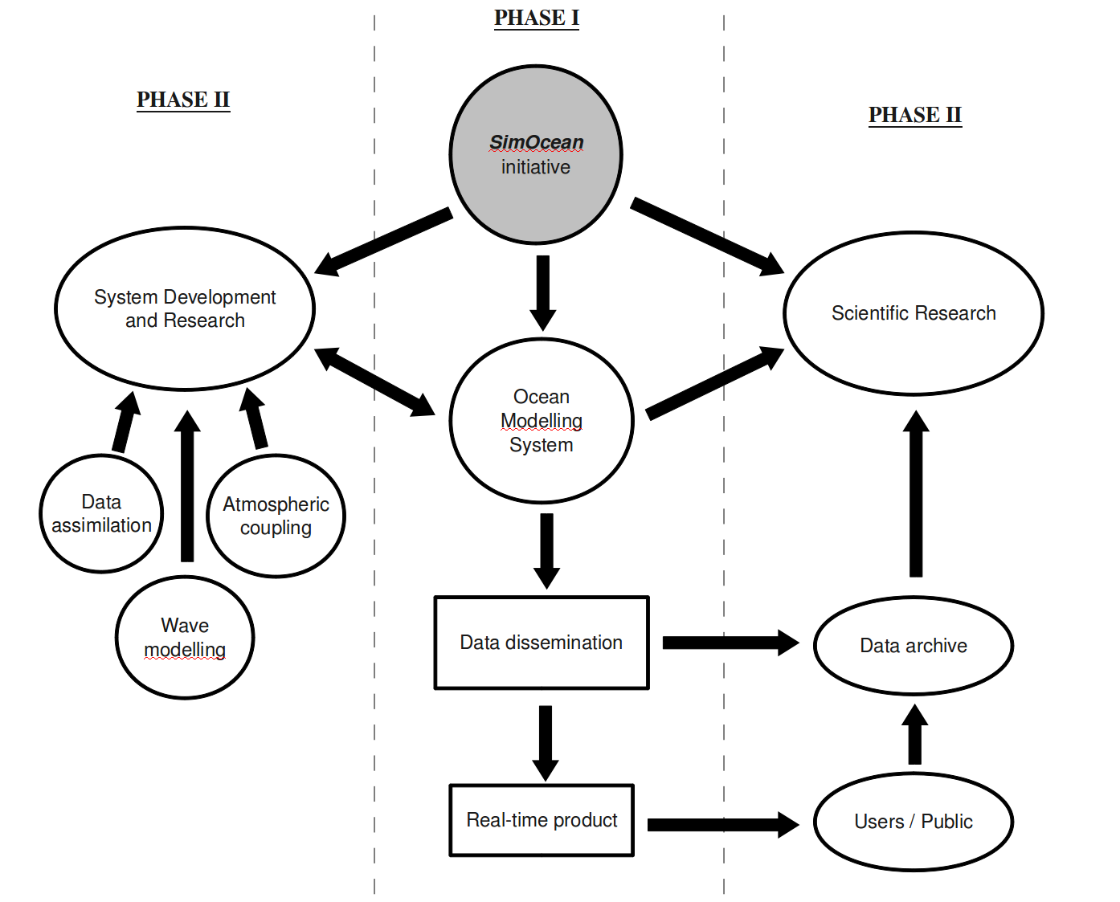
SimOcean
Dissemination platform!

Slide 11
Operational Oceanography
Range of scales / questions and tools
Modelling:
ROMS / MOM – Bluelink
Boundary conditions/ coupling and assimilation
Small scale examples
Coastal management examples
Observations: PICO

Slide 12

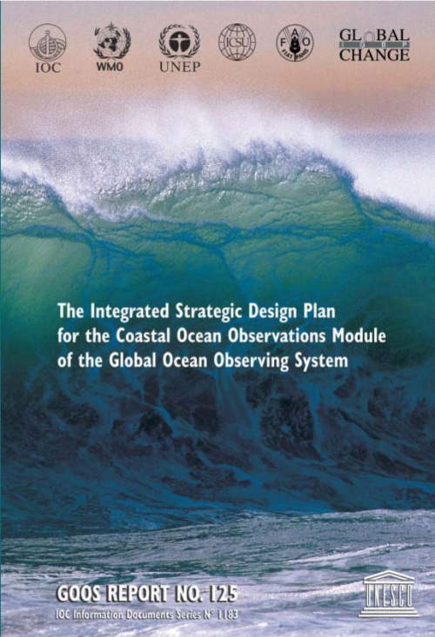
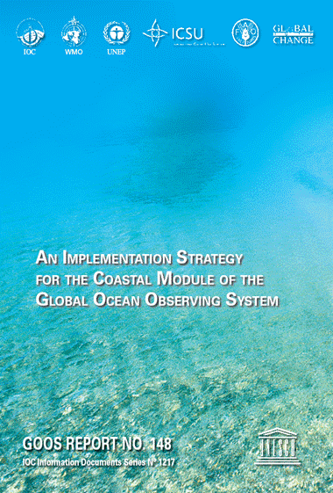
Panel for Integrated Coastal Observations (PICO)

Slide 13
Draft Implementation Plan Outline:
Chapter 1: Vision and Background
Chapter 2: Phenomena of interest (all) and types of end users with
mapped, user-driven products and indicators
Chapter 3: End to End System Approach for initial subset (6 total; see
next slide) of Phenomena of Interest (PoI)
Chapter 4: Cross-cut across PoIs : common measurement, modeling,
information delivery approaches; common variables
Chapter 5: Integrated system of systems approach; relation between
regional and global – scaling issues
Chapter 6: Build-out plan: Phased prioritized build-out plan; pilot
projects; Responsible advisory, oversight & implementation
bodies; Funding Mechanisms and Community Partnerships;
Capacity building

Slide 14
Initial Phenomena of Interest Focus:
Coastal Flooding Events
Exposure to Waterborne Pathogens
Ocean Acidification (new, added at PICO-II)
Habitat modification and loss
Euthropication – hypoxia
Abundance of exploitable living marine resources

Slide 15
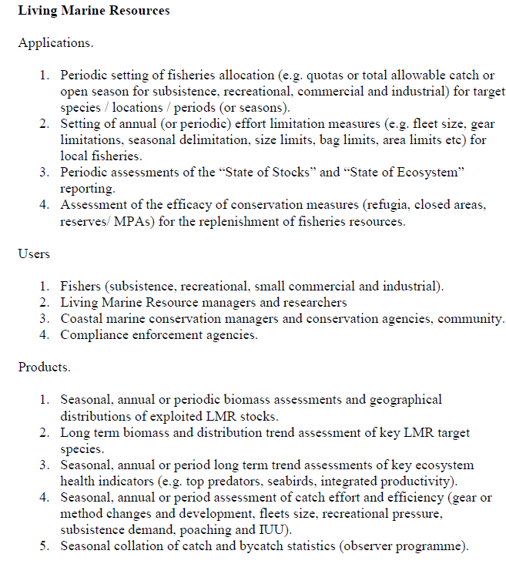

Slide 16
Integrating coastal process studies, observations,
modeling and other tools for ICZM
Or
Why its important to carefully understand (research)
the domain in which you are working and to know its
natural history

Slide 17
Baseline State
Fluvial supply
Prevailing metocean
variability
Sediment budget / dynamics
Scaled hydrodynamics
and water column structure
dynamics and variability
Equilibrated shoreline dynamic

Slide 18
Perturbed State
Perturbed fluvial supply
Changing metocean
variability
Perturbed sediment
budget / dynamics
Perturbed hydrodynamics
and water column structure
dynamics and variability
Perturbed shoreline dynamic
Shifting baselines / cumulative impacts

Slide 19
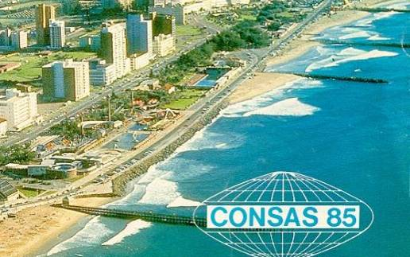
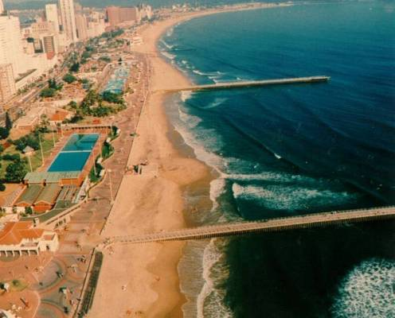

Before
After
Sand removed
from littoral system
Sand bypassing scheme
feeds beaches
We optimise beach nourishment:
Volumes, Locations, Rates…

Slide 20
COASTAL SEDIMENT BUDGET - SYNTHESIS
Estimated coastal sediment budget including dams (& dredging), excluding mining
In the long-term, the amount & character of Ethekwini coastal sediments is ultimately determined by the larger rivers within the region.
The sand fraction of sedimentary inputs from 18 Ethekwini rivers is roughly = all other sand sources feeding Ethekwini coastal area.
Notes:
The amounts and locations of the sand sources and sinks, as well as longshore transport rates are graphically indicated in a synthesis of the Ethekwini coastal sediment budget. From these studies, it follows that in the long-term, the amount and character of Ethekwini coastal sediments are ultimately determined by the larger rivers (and the nature of their catchments) within the region. From this holistic understanding of the coastal sediment budget, it is roughly estimated that the sand fraction of the sedimentary contribution/inputs from the Ethekwini rivers is probably about equal to all other sand sources feeding the Ethekwini coastal area.
While it appears that the mining plus dam trapping account for more than the natural yield, there is still some 30% of the yield to the coast remaining, due to some rivers being over mined, while others still have some net yield. (It is further estimated that the present total mean annual shortfall, compared to estimated “natural” rates, in sand supply from all sources (fluvial, marine, etc.) to the Ethekwini coast could be in the order of 300 000 m3/yr.)

Slide 21
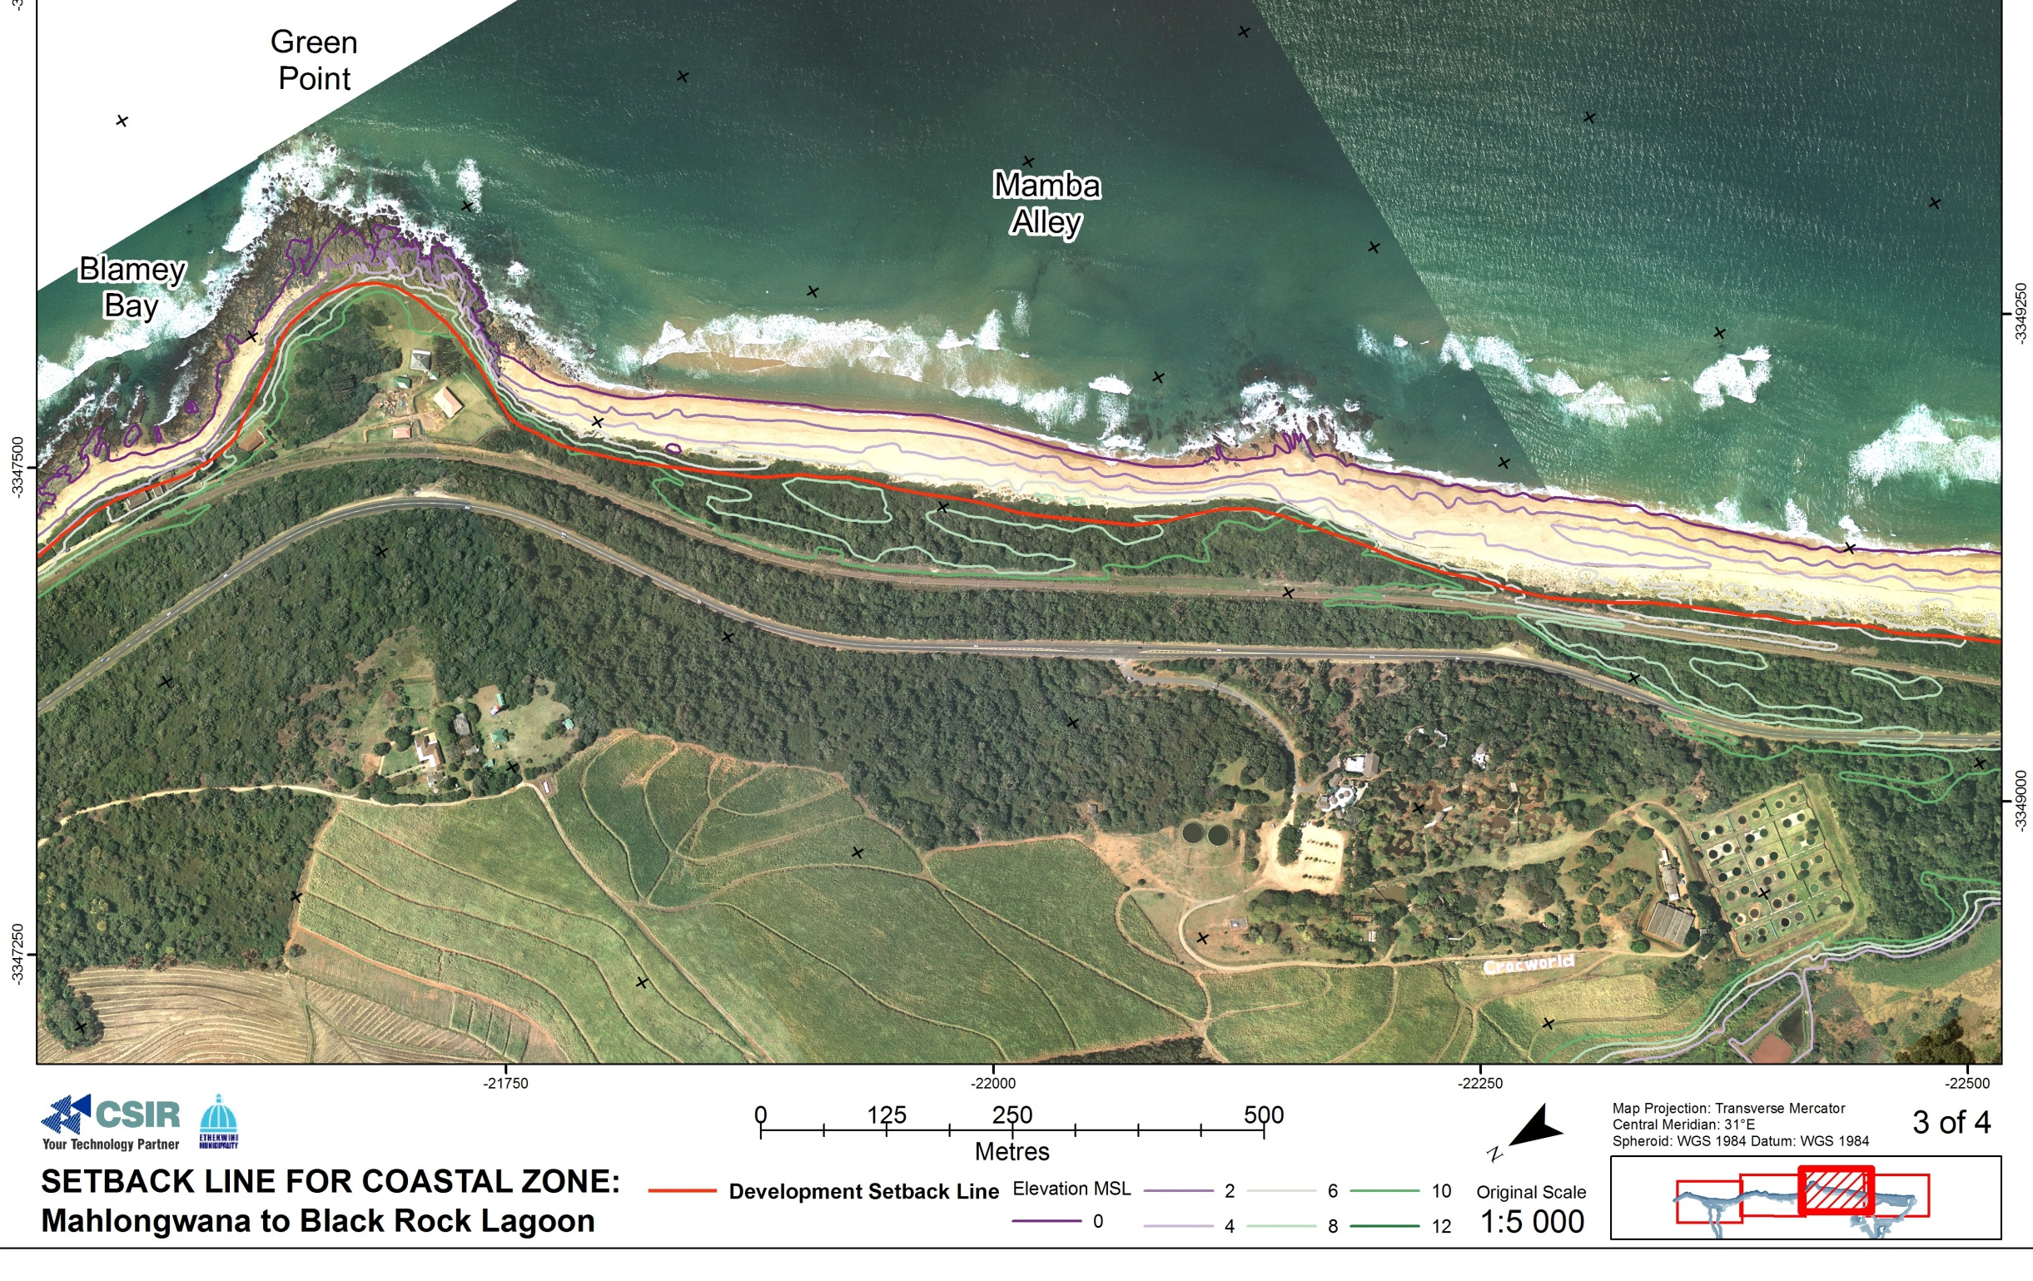
Potential landward shift of storm wave run-up line due to a 2 m rise in sea level + erosion due to SLR
- - Approx. present storm run-up line
● ● Potential future storm run-up line
due to a 2 m rise in sea level
■ ■ Potential future storm run-up line
due 2 m SLR + erosion (< 75 m)
Mixed sandy/rocky shore
- semi erosion resistant
Hard erosion resistant headland
Soft sandy beaches
- vulnerable to erosion
Notes:
QUESTIONS?

Slide 22
Introducing CoDAST
Coastal Development Assessment Scoping Tool
Ensures that assessment scale is appropriate
Ensures that all appropriate environmental variables are considered
Accounts for cumulative impacts are accounted for
Identifies & specifies data inputs and product outputs
Proposes options for approach to assessment (including range of tools)

Slide 23
Introducing CoDAST
Coastal Development Assessment Scoping Tool
 | Scope of impact considerations & issues | Outputs Required | Time & space scales | Data Requirements | Methods & tools
Pipelines & other discharges
Solid Structures
Water & Sediment Flow Modification
Dredge Channels
Dredge Spoils
Dredge Processing
River Flow modification
Beach Mining
Estuarine sand-mining and dredging
Estuarine Mouth State modification (artificial breaching)
Sediment bypass schemes

Slide 24
Introducing CoDAST
Coastal Development Assessment Scoping Tool
 | Scope of impact considerations & issues | Outputs Required | Time & space scales | Data Requirements | Methods & tools
Pipelines & other discharges
Solid Structures
Water & Sediment Flow Modification
These range from physical considerations (including erosion, deposition, flow rates, water column properties), through water quality considerations (including issues such as eutrophication, metal accumulation, salinity changes), to ecosystem considerations (including habitat changes) These considerations then assist in defining the scale, data and tools that would be applied to the study under consideration.

Slide 25
Introducing CoDAST
Coastal Development Assessment Scoping Tool
Assumptions & Limitations:
Physical and abiotic only (at this stage)
Assumes appropriate governance framework
Issues with connecting tools and methods (interoperability)

