Slide 1





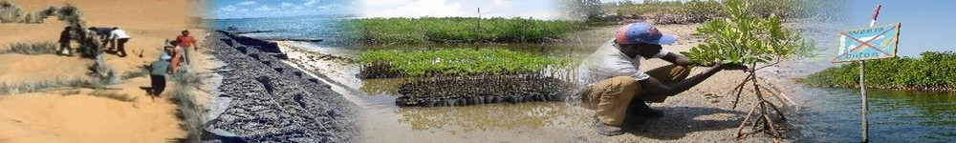
ACCC Program
Adaptation to Climate and Coastal Change in West Africa
UNDP/GEF-UNDP–UNESCO/IOC
Adaptation aux Changements Climatiques
et Côtiers en Afrique de l'Ouest

Slide 2




History of the ACCC program Coming from the African Process for the Development and Protection of coastal and marine environment (2000-2003) 2003 : The Senegalese Gvt (coordination of the environment component of NEPAD) asked UNESCO/IOC to develop a project proposal for submission to the GEF 2004 : Technical meeting for the project preparation (Dakar, March 2004). Submission of a PDF B proposal to the GEF Secrétariat by the end of 2004 which was approved in January 2005.
ACCC
NEPAD

Slide 3
ACCC
NEPAD
2005-2006 : PDF-B implementation and submission of a Full Size Project to GEF
PDFB workshops
National Reports

Slide 4
ACCC
NEPAD
2007 Full size Projet approved, organization of CLEP (Dakar, May), Working workshop on monitoring/evaluation (Praia, November)
2008 Signature of the Prodoc by the 5 countries
Preparation of the action plan/budget/M&E framework
The national teams start to be established
Recruitment of the regional coordinator
Regional inception workshop (24-26 November)

Slide 5
ACCC
NEPAD
The ACCC program in the GEF portfolio
SPA (Strategic Priority on Adaptation) / biodiversity
Implementing Agency: UNDP/GEF
Executing Agencies: UNDP & UNESCO/IOC
4 years (3 years after the inception meeting; should end by Dec 2011)
Total budget : 13.18 million US $ of which
3.3 millions from GEF;
6.24 millions from Participating Countries (cash/in kind)
510,000 UNESCO & UNDP (cash/in kind)
3.13 millions from Partners (in-kind)

Slide 6
ACCC
NEPAD
Goal of the project: Reduce vulnerability and strengthen the adaptive capacities of countries and communities to negative impacts of climate change
Objectives of the project: Implement and conduct an array of efficient resistance mechanisms to reduce the impacts of coastal erosion du to climate change in vulnerable zones of 5 countries of West Africa

Slide 7
ACCC
NEPAD
Climate Change
Other factors
Sea level rise
Identified problem
Coastal erosion
ACCC Project
Impacts on ecosystems, populations and economies
Increase response capacities
Responses of systems

Slide 8
ACCC
NEPAD
Strategy of the project: Strengthen Adaptive capacities in a difficult context
Better understanding of vulnerability based on collect and access to data; as well as through the strengthening of existing networks
Strengthen coordination mechanisms as well as legal instruments for a better integrated coastal zones management and a more efficient approach
Integration of climate change issues into sectoral policies, development and coastal zone management plans
Sharing and duplication of experiences
Large involvement of all stakeholders and increased conscience of populations

Slide 9
ACCC
NEPAD
Strategy of the project: it works at three levels
At local level (pilot sites) to develop activities to combat coastal erosion, develop sensitization in order to strengthen coastal communities to respond to climate change while enhancing biodiversity
At national level, mainly to integrate CC issues into national development plans, raise the awareness
At regional level to develop cooperation on these issues, develop ztraining, enhance communication and exchange of experiences

Slide 10
 | National Agencies(DNP) | National Coordinator (CNP)
Mauritanie | MDEDD/Dir Aires protégées et littoral Mohamed Lemine Ould Ahmedou Chérif | Demba Marico
Sénégal | Ministère Env Prot Nat/DEEC Elimane Ba | Jean Laurent Kaly
Cap Vert | Min Env Agriculture / Direc Génér Env Borges | Nuno Ribeiro
The Gambia | NEA Momodou SARR | Dodou Trawally
Guinée Bissau | Secr Etat Env Dvpt Dur/Dir Env Tomas Gomes Barbosa | Joao Raimundo Lopes

Slide 11
Project Outcomes
ACCC
NEPAD
Five components: 2 national components and 3 regional components
RESULT 1: Pilot activities to strengthen the adaptive capacity and the
resistance of coastal ecosystems côtiers
RESULT 2 : Integration of adaptation into policies and integrated coastal zone
management programs
RESULT 3: Strengthening the combat against coastal erosion and
strengthening capacities in integrated coastal zone management
RESULT 4 : Learning, evaluation and increased management of adaptation
RESULT 5 : Management Unit of the Project

Slide 12




ACCC
National components
Component 1 | Pilot projects to reduce coastal erosion linked with climate conditions
Component 2 | Integration of CC issues and activities and programmes for management of the coastal zones Design of national policies and programs to facilitate adaptation to CC in the coastal zones Reproduction of successful communities approaches to adapt to coastal erosion

Slide 14
ACCC
Countries | Designed sites | Area | Characteristics | Activities
Mauritanie | Nouakchott | 80 ha (4 km of coastline) | Urbanized area, inundations, breaches in the littoral dunes | Restauration of the littoral dunes with vegetation
Sénégal | Palmarin | 5 - 6 ha (10 km of coastline) | Community reserve, estuarine zone | Reforestation of the littoral strip and mangrove restoration
Gambie | Tanji river and Bijol islands | ? | Ramsar site, biodiversity, zone estuarienne et îles | Ecotourism, raising awareness
Cap Vert | Ribeira de Lagoa (Maio island) | 13 ha | Estuarine zone ; natural, park biodiversity (turtles), agriculture, dam, salinization, erosion | Information, sensitization, restoration of vegetal cover (dunes), integrated management plan of the river and coastal zone
Guinée Bissau | Varela | 7 km, 100 ha | Erosion, turtles nesting area | Plantation, biodiversity monitoring, formation, study of the coastal erosion

Slide 15

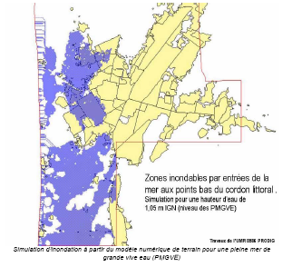
ACCC
NEPAD
Mauritanie / Nouakchott Site characteristics : littoral dune
Extract from the Rapport sur les risques d’inondation de la zone littorale de Nouakchott
SenHoury et al., 2003

Slide 16
ACCC
NEPAD
Mauritanie / Nouakchott Site characteristics : littoral dune
Strong degradation of biodiversity
High anthropic pressures
11 breaches among which 8 are linked
with sand mining

Slide 17





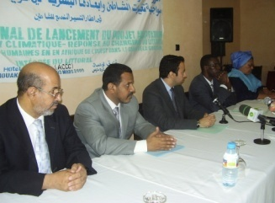
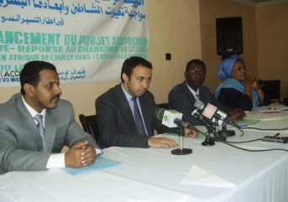
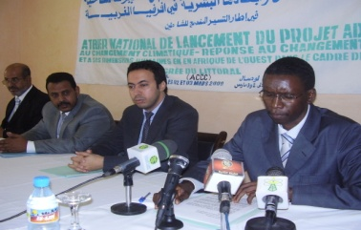
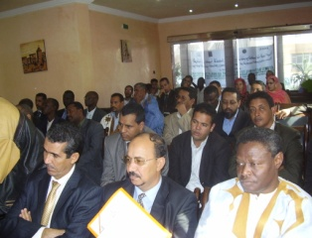
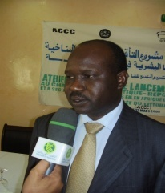
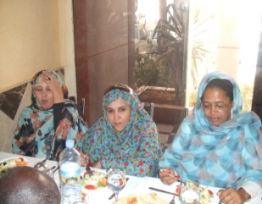
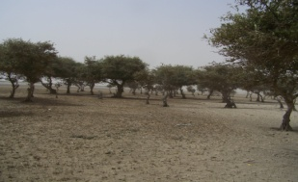
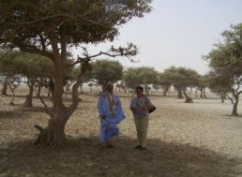
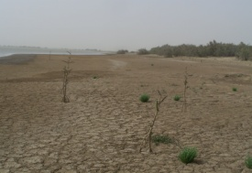
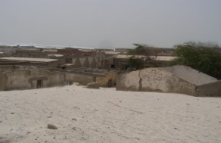
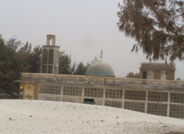
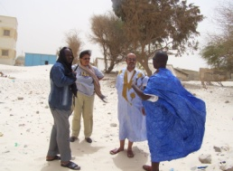
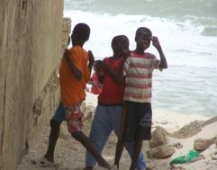
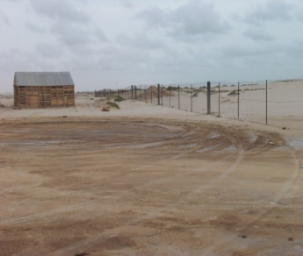
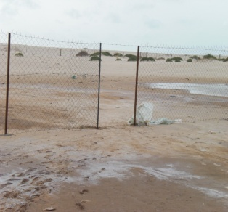
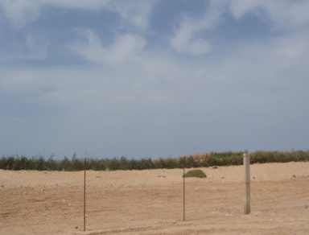
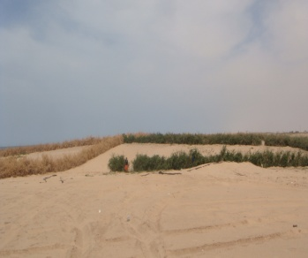
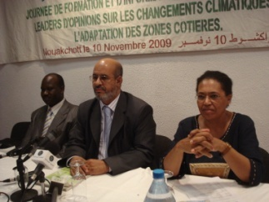
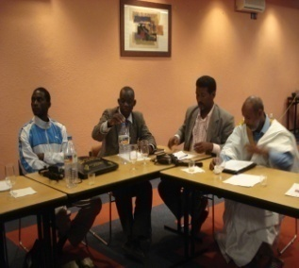
ACCC
Adaptation au changement climatique – Réponse au changement du littoral et à ses dimensions humaines en Afrique de
l’Ouest dans le cadre de la gestion intégrée du littoral (ACCC/Mauritanie)
Projet - UNDP/GEF – UNESCO/IOC
Atelier de démarrage
Visite du PND et de N’Diago
Activités sur site

Slide 18
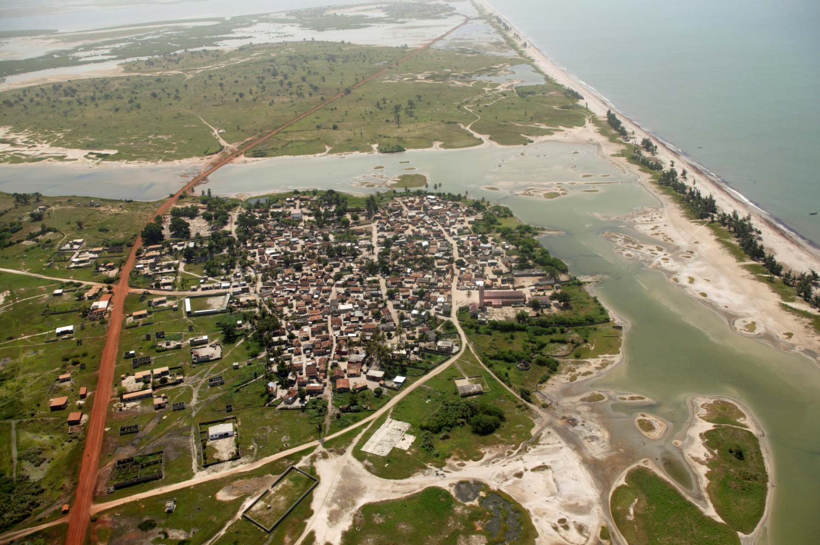
ACCC
NEPAD
Sénégal / Palmarin Site characteristics : Littoral dunes and mangroves

Slide 19
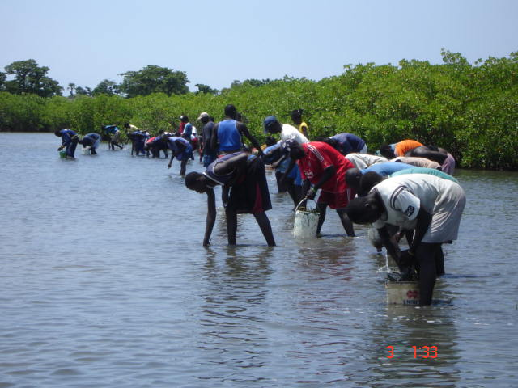

Slide 20
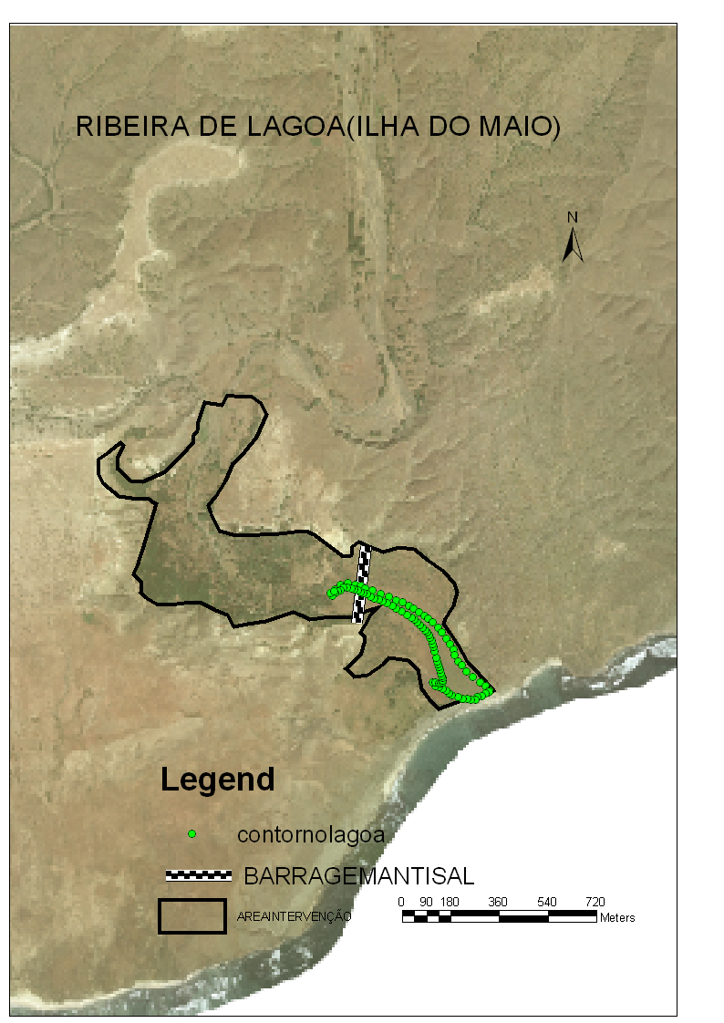
ACCC
NEPAD
Cap Vert / Maio Site characteristics : Estuary and littoral dune

Slide 21
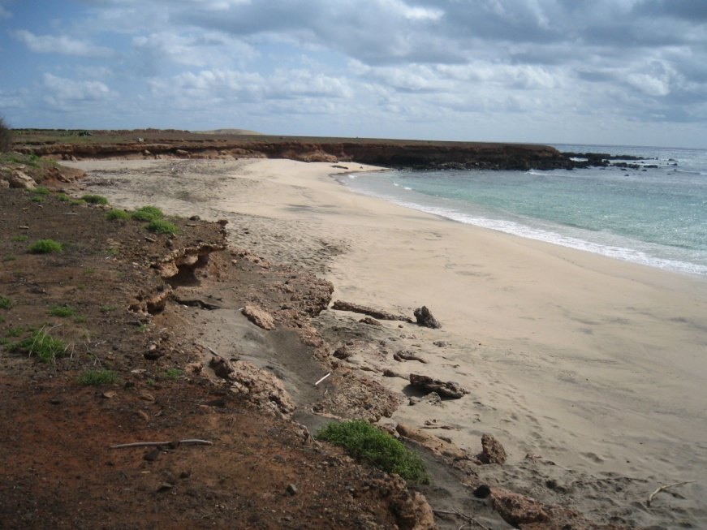
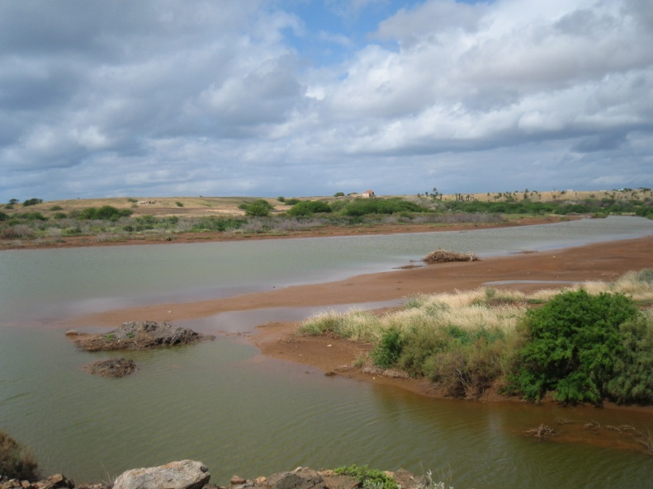
ACCC
NEPAD
Cap Vert / Maio Site characteristics : Estuary and littoral dune

Slide 22
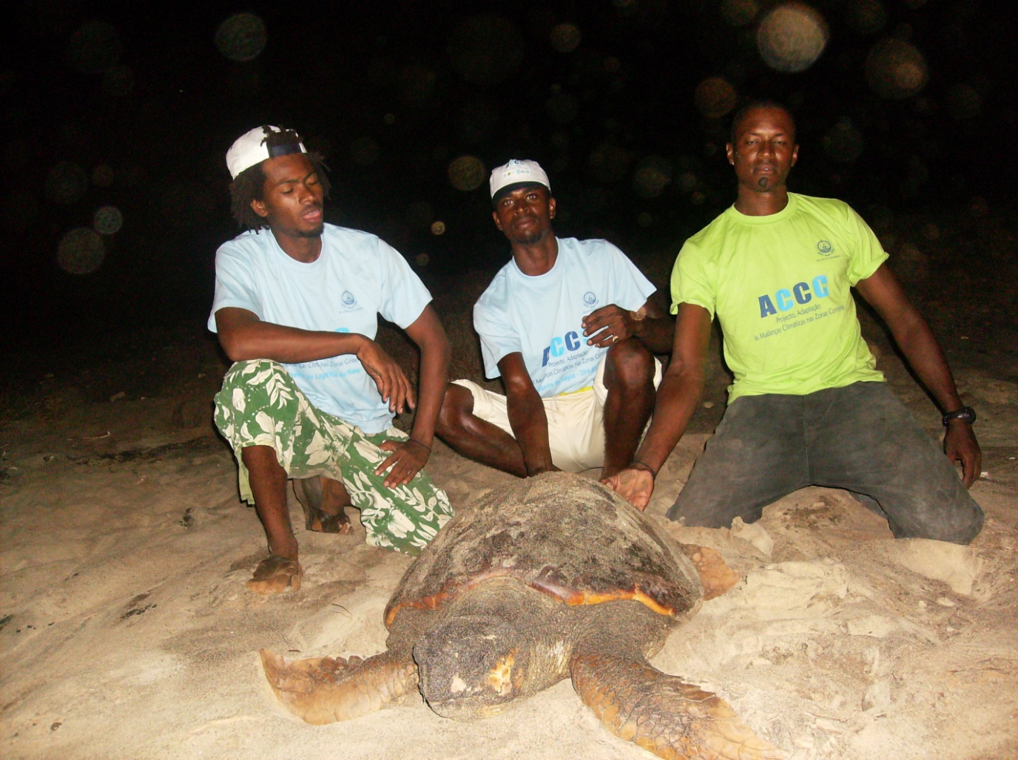

Slide 23
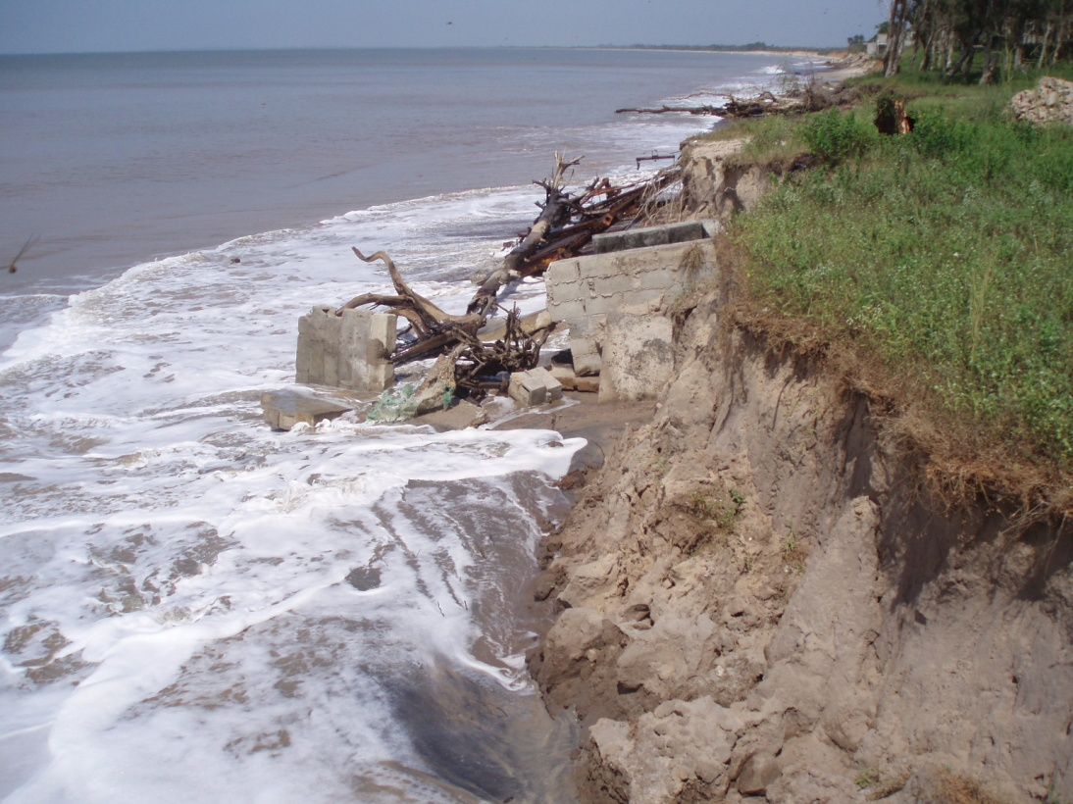
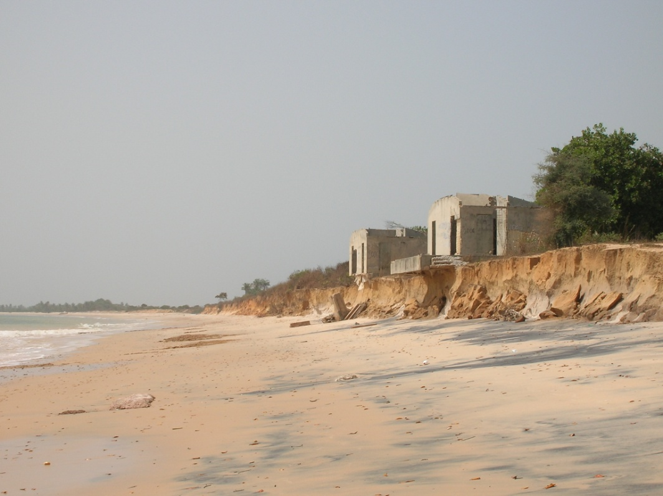
ACCC
NEPAD
Guinee Bissau / Varela Site characteristics : Beach
Photo J.R. Lopes

Slide 24
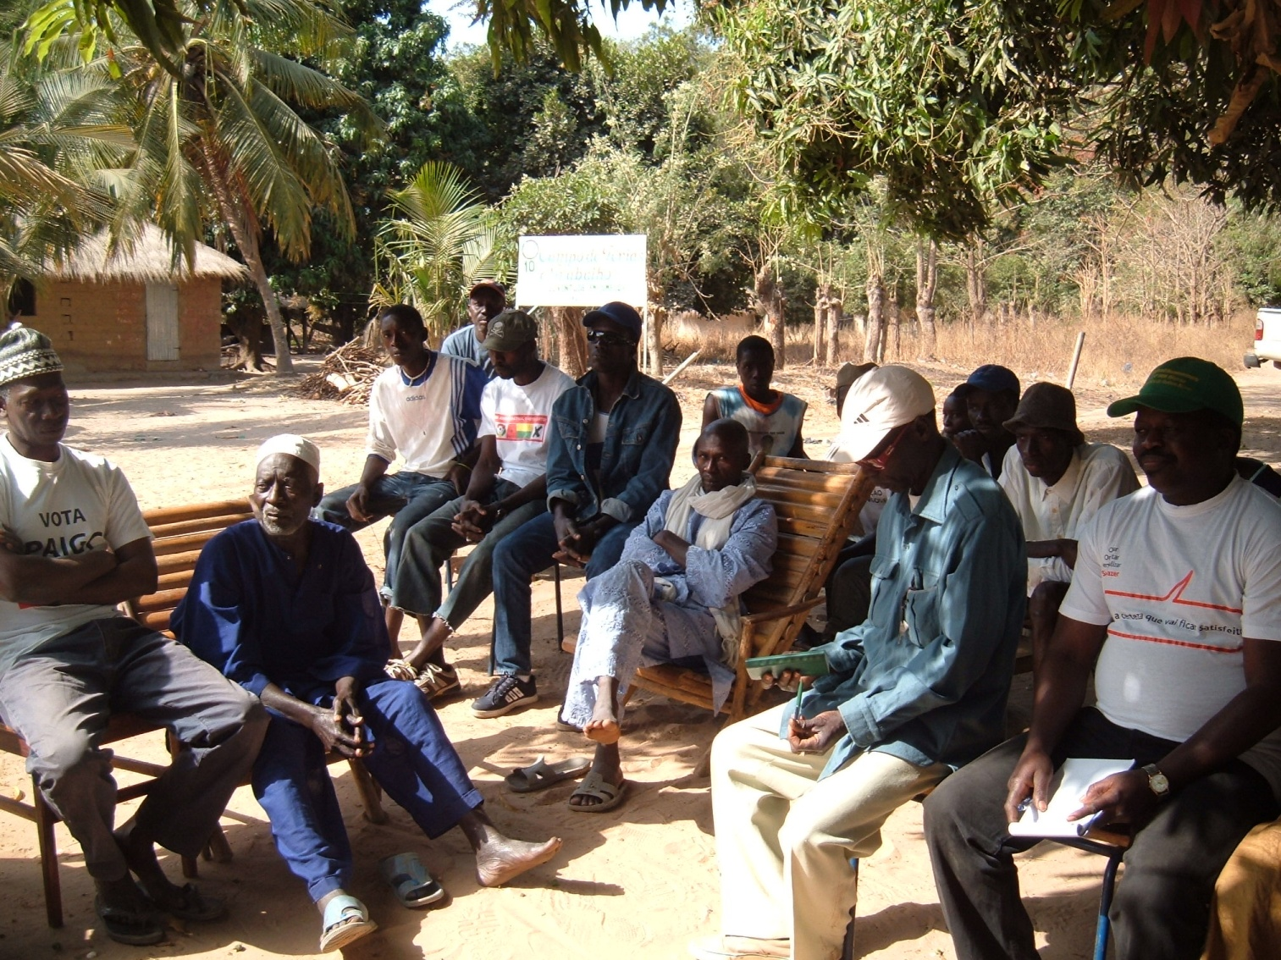

Slide 25
ACCC
Regional components
Component 3 | Strengthening institutional capacities and human resources to design and implement adaptation strategies and measures in coastal zones Install an exchange mechanism to collect, store and diffuse best practices and documentation
Component 4 | Install a learning mechanism Strengthening of the regional cooperation to better take in account climate change aspects in coastal zone management
Component 5 | A regional coordinating unit is operational

Slide 26
ACCC
Regional Inception meeting (26-28 November 2008): adoption of working plan, budget, monitoring-evaluation framework for regional components
National inception meetings
Guinée Bissau: 20 February 2009
Mauritanie: 2-3 March
Cap Vert: 7 April
Gambie: 16 April
Sénégal: 1er July

Slide 27
ACCC
Regional training workshops
Climate change and coastal erosion (23-25 April, Dakar)
Technics for mangrove restoration (27-30 April, Saly)
Technics for littoral dunes reforestation (13-16 June, Nouakchott)
Redesign of the website (www.accc-africa.org )
Regional workshop of parlementarians and local decision makers (3-6 August, Praia)
Training of trainers workshop on Sandwatch (25-28 August, Praia)

