Slide 1
Resolving Current and Future Conflicts between Tourism and Ecosystems
What are the Information Needs and Gaps?

Slide 2
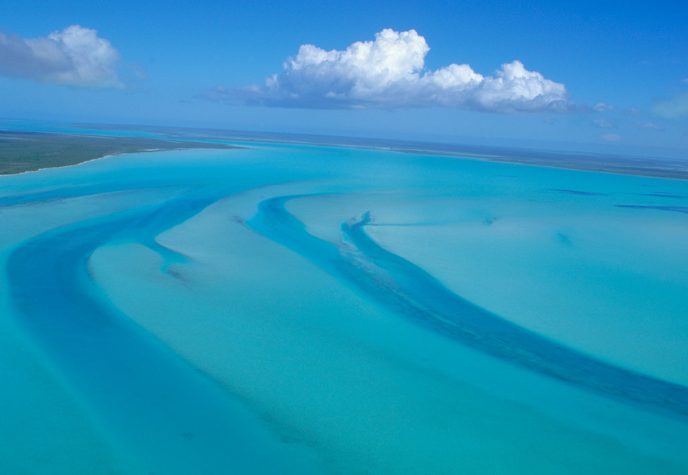
The Great Bahama Bank

Slide 3
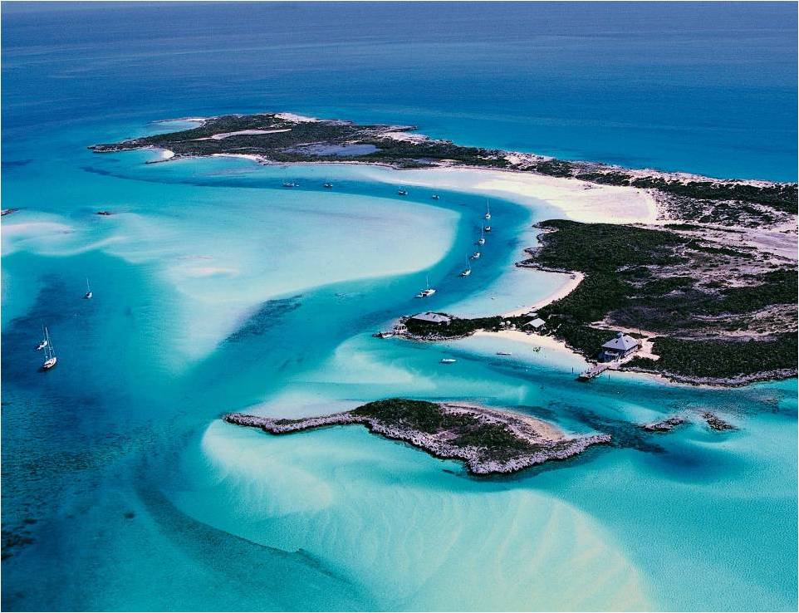

Slide 4
Major Ecosystems of The Bahamas
Coral Reefs
Seashores
Rock Seashores
Whiteland Coppice
Blackland Coppice
Pine Forest

Slide 5
Additional Ecosystems
The Bahamas has the largest Mangrove System on the planet. They comprise of :
Red Mangrove - Red mangroves exclude salt by having significantly impermeable roots which are highly suberised, acting as an ultrafiltration mechanism to exclude sodium salts from the rest of the plant.
Black Mangrove - (Avicennia germinans Stearn); black mangroves have characteristic pneumatophores (oxygen-obtaining root projections) surrounding their bases, projecting some 5-20 cm out of the sediment.
White Mangrove - Occupying higher land than the red and black mangroves, the white mangrove (Languncularia racemosa) has no visible aerial roots, unlike the black mangrove which has pneumatophores and the red mangrove with prop roots.
Buttonwood Mangrove -Often found in the upland transitional zone, the buttonwood (Conocarpus erectus) is often associated with mangrove communities.

Slide 6
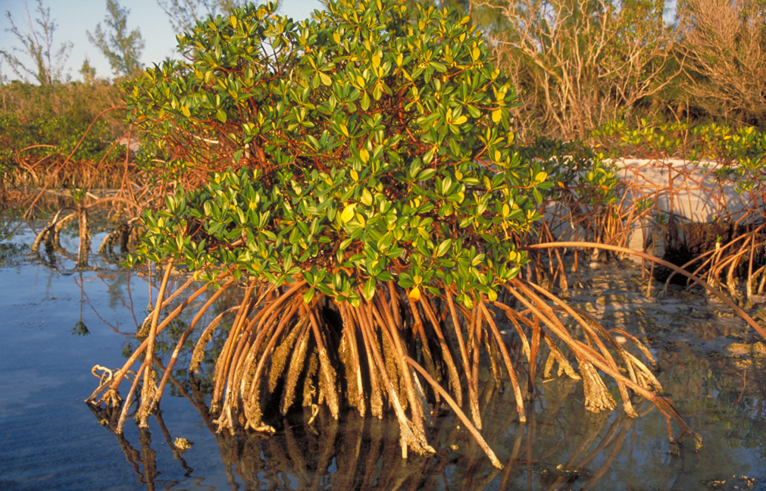
Red Mangrove

Slide 7
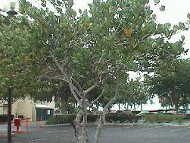
White Mangrove

Slide 8
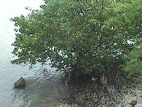
Black Mangrove

Slide 9
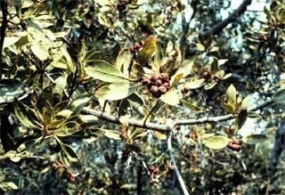
Buttonwood Mangrove

Slide 10
Coral Reefs
Coral Reefs are the natural wonders of the world. Over one hundred different species decorate the ocean floor with an infinite variety of patterns appearing as spires and pinnacles of pillar corals, “trees and shrubs” of stone hard elkhorns, huge boulders that look like giant brains, and delicate flower-like figures of lettuce and leaf corals.

Slide 11
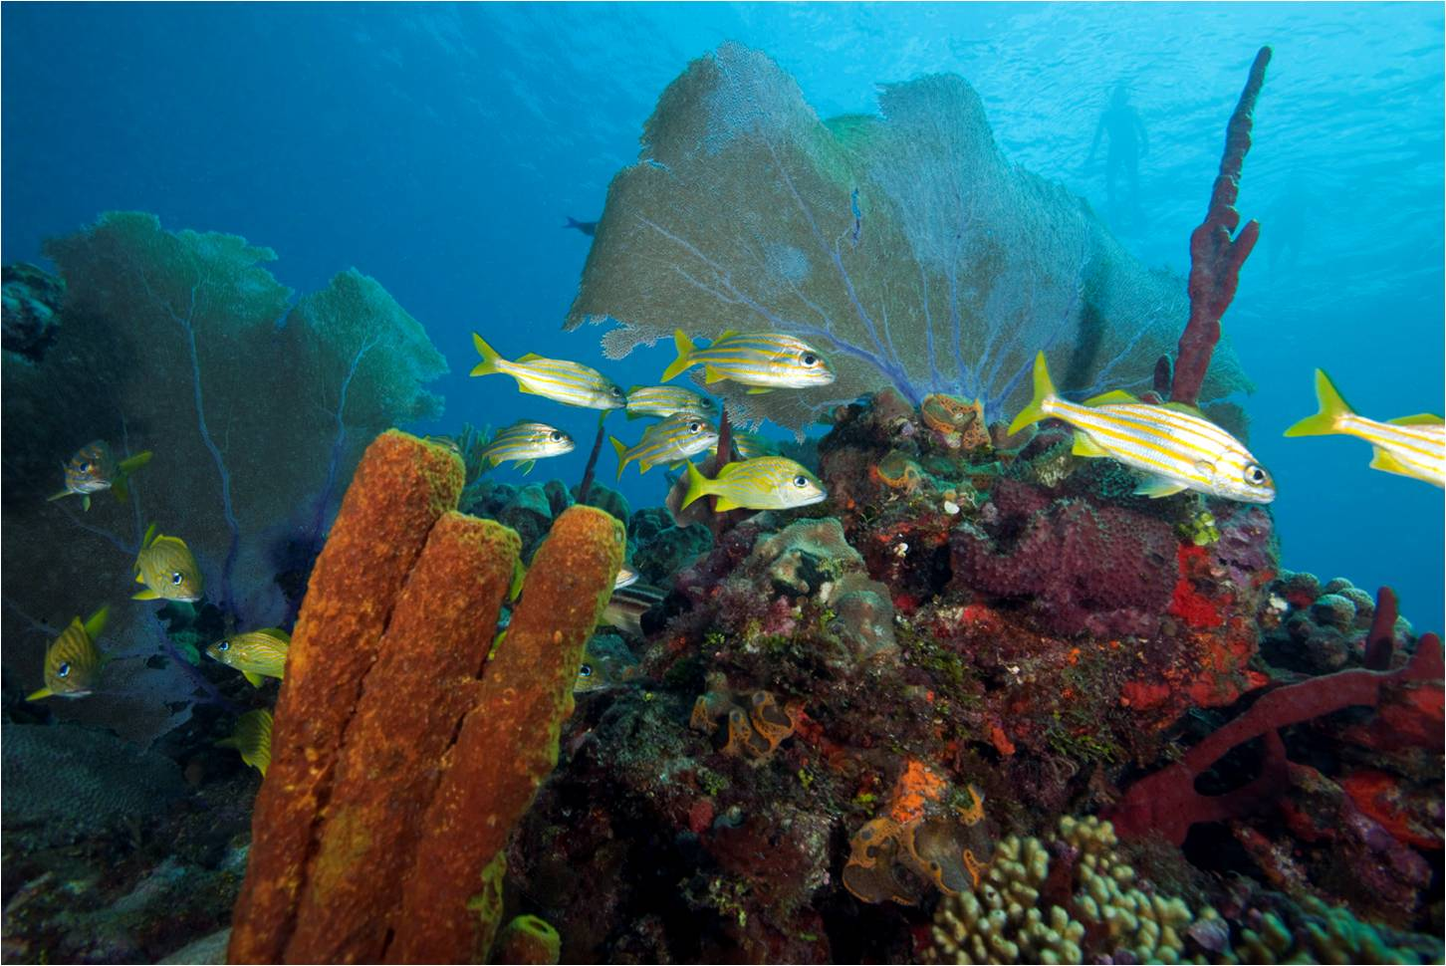
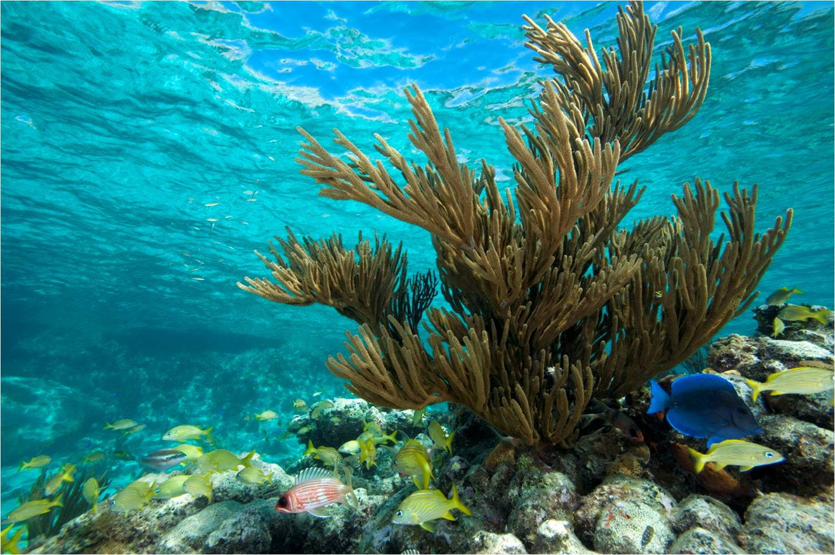
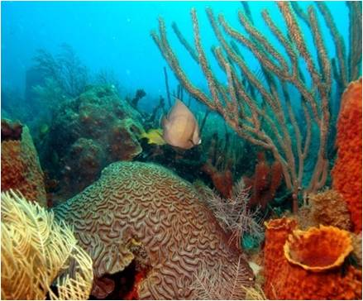
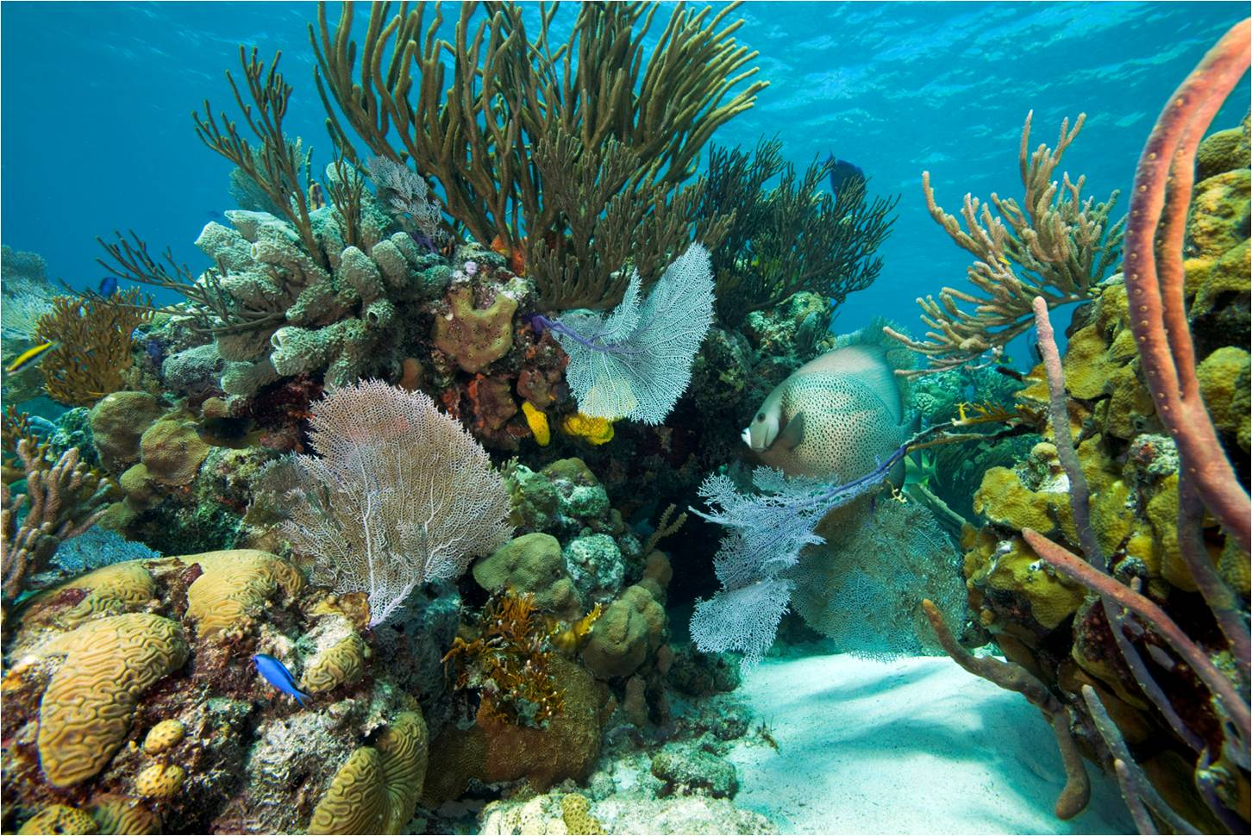

Slide 12
Sandy Seashore
An area filled with an interesting mix of unique plants and animals that have be able to adapt to Bahamian eco-environment where the soil is infertile, and it is often windy, dry and salty.
Along the sandy seashore, there are no large rocks, algae or tidal pools. In the context of The Bahamas, our seashores are divided into four general zones: Intertidal, Pioneer, Fixed Dune and Scrub Woodland Zones.

Slide 13
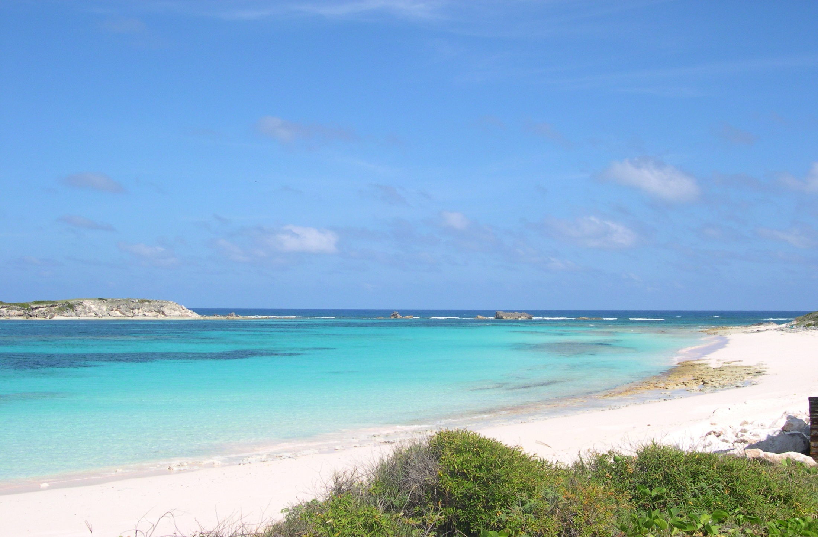

Slide 14
The Rock Seashore
This type of seashore is comprised mostly of limestone rock that have over time, worn away to form ridges and crevices. A safe haven for small creatures to hide, the ridges of this type of seashore are also natural habitats for a variety of marine plants (algae).
The creatures of the rocky shore belong to different families of: Molluscs, Crustacea, Echinderms, Annelida and Fish.

Slide 15
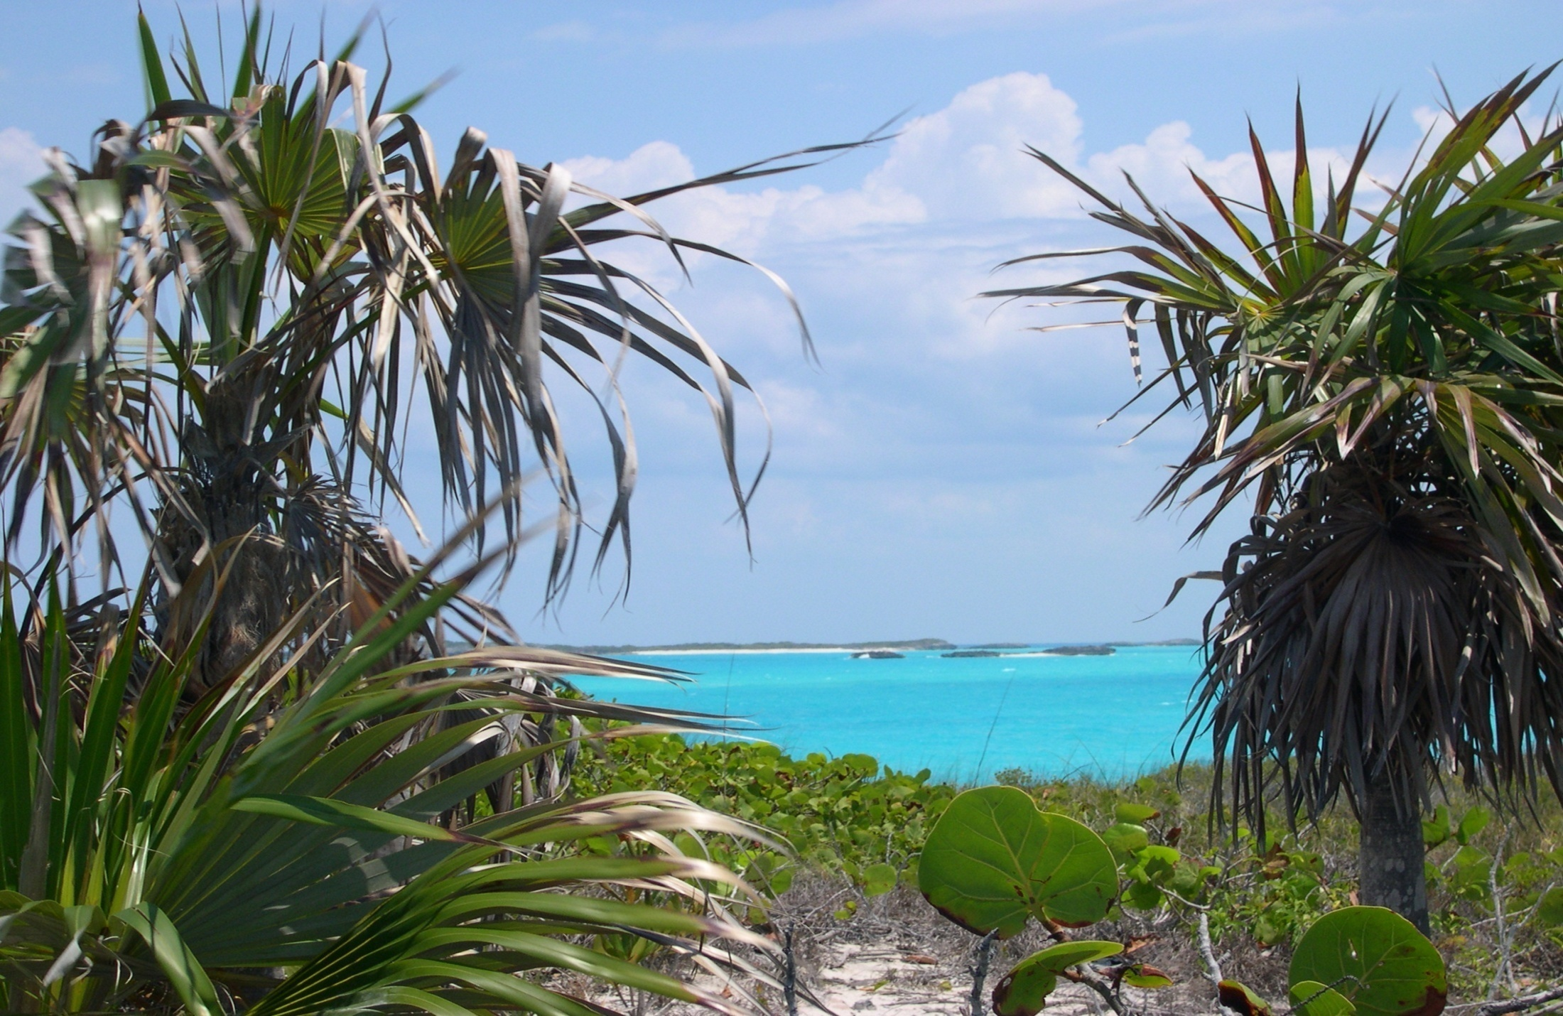

Slide 16
Whiteland Coppice
An extremely divers grouping of native trees and plants found in the Bahamian forest. Better known as Coppice locally, there are said to be over 100 species of trees and shrubs per sq mile in the area.
What is most interesting is the fact that on every one of the Islands of The Bahamas, there presents a different variation of Coppice, depending on the location of the island and the amount of rainfall it gets. Variations are also dependent on whether the area was used in the past by early inhabitants of the island.

Slide 17
Blackland Coppice
A major distinction of this type of coppice are the thick and heavy trees that tend to dominate this setting. Heavy wood trees such as mahogany, horseflesh, mastic and cedar are though to be some of the trees that greeted Columbus on his voyage to the islands of The Bahamas.
Of all of the islands in The Bahamas, there exist only two ancient and primeval Black Coppice Forest with trees that form canopies of over 60 feet in height. They are located on the islands of Little Inagua and South Andros.

Slide 18
Pine Forest
The Caribbean Pine (Caribaea vs. bahamensis) is also known as the Yellow Pine.
The Caribbean Pine is a light-demanding species that requires open areas with no competition from shading broad-leafed plants.
Known as “fire climax communities” by botanists, it becomes important for periodic fires to occur in order to remove the top shading in order to allow the juvenile pines to eventually replace adult trees.

Slide 19
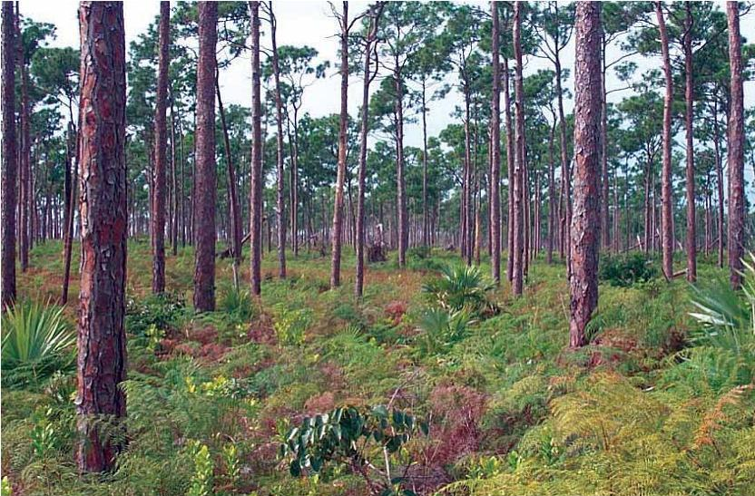

Slide 20
Ecosystems Needs, Gaps and Mitigation

Slide 21
Key Steps from The Bahamas
Ecological Gap Analysis
Identification of the major biodiversity targets (habitat types, species, and ecological processes) in The Bahamas?
Consolidate and Evaluate the occurrence and status of biodiversity
Conduct and analysis of all protected area in The Bahamas
Identification of Gaps based on existing biodiversity and protected areas.

Slide 22
Key Results of Gap Analysis
The Bahamas wide results provided an overall picture of the current level of protection major habitats and key species receive from the existing protected area system.
Terrestrial and freshwater targets generally receive better protection than marine targets. However, most targets still do not meet minimum CBD (convention on Biological Diversity) 10% protection goals.

Slide 23
Mangroves, tidal creeks, and seabirds were the only biodiversity targets to exceed the minimum CBD goal of 10% protection, but still failed to meet the higher target specific conservation goals.
Again, it’s worth mentioning that The Bahamas has the largest remaining Mangrove System on the Planet

Slide 24
Interestingly, those targets that are of greatest importance to the national economy of Tourism and The Bahamas such as groundwater, beaches, mangroves, spawning aggregations, and reefs receive little to no protection. This is viewed as a major GAP.
(The Bahamas National Protected Area Systems, Master Plan 2008)

Slide 25
Despite the intuitive logic of the need to protect natural resources in a tourism-based economy, there are two levels of challenges faced by protected areas in The Bahamas.
The first is to translate the Government’s stated commitment into a legislative agenda that provides “legally granted special management rights” and
The second is to ensure that once statutorily established, both marine and terrestrial environments are effectively managed for
the long term conservation of the country’s
natural resources. (The Bahamas National Protected Area
Systems, Master Plan 2008)

Slide 26
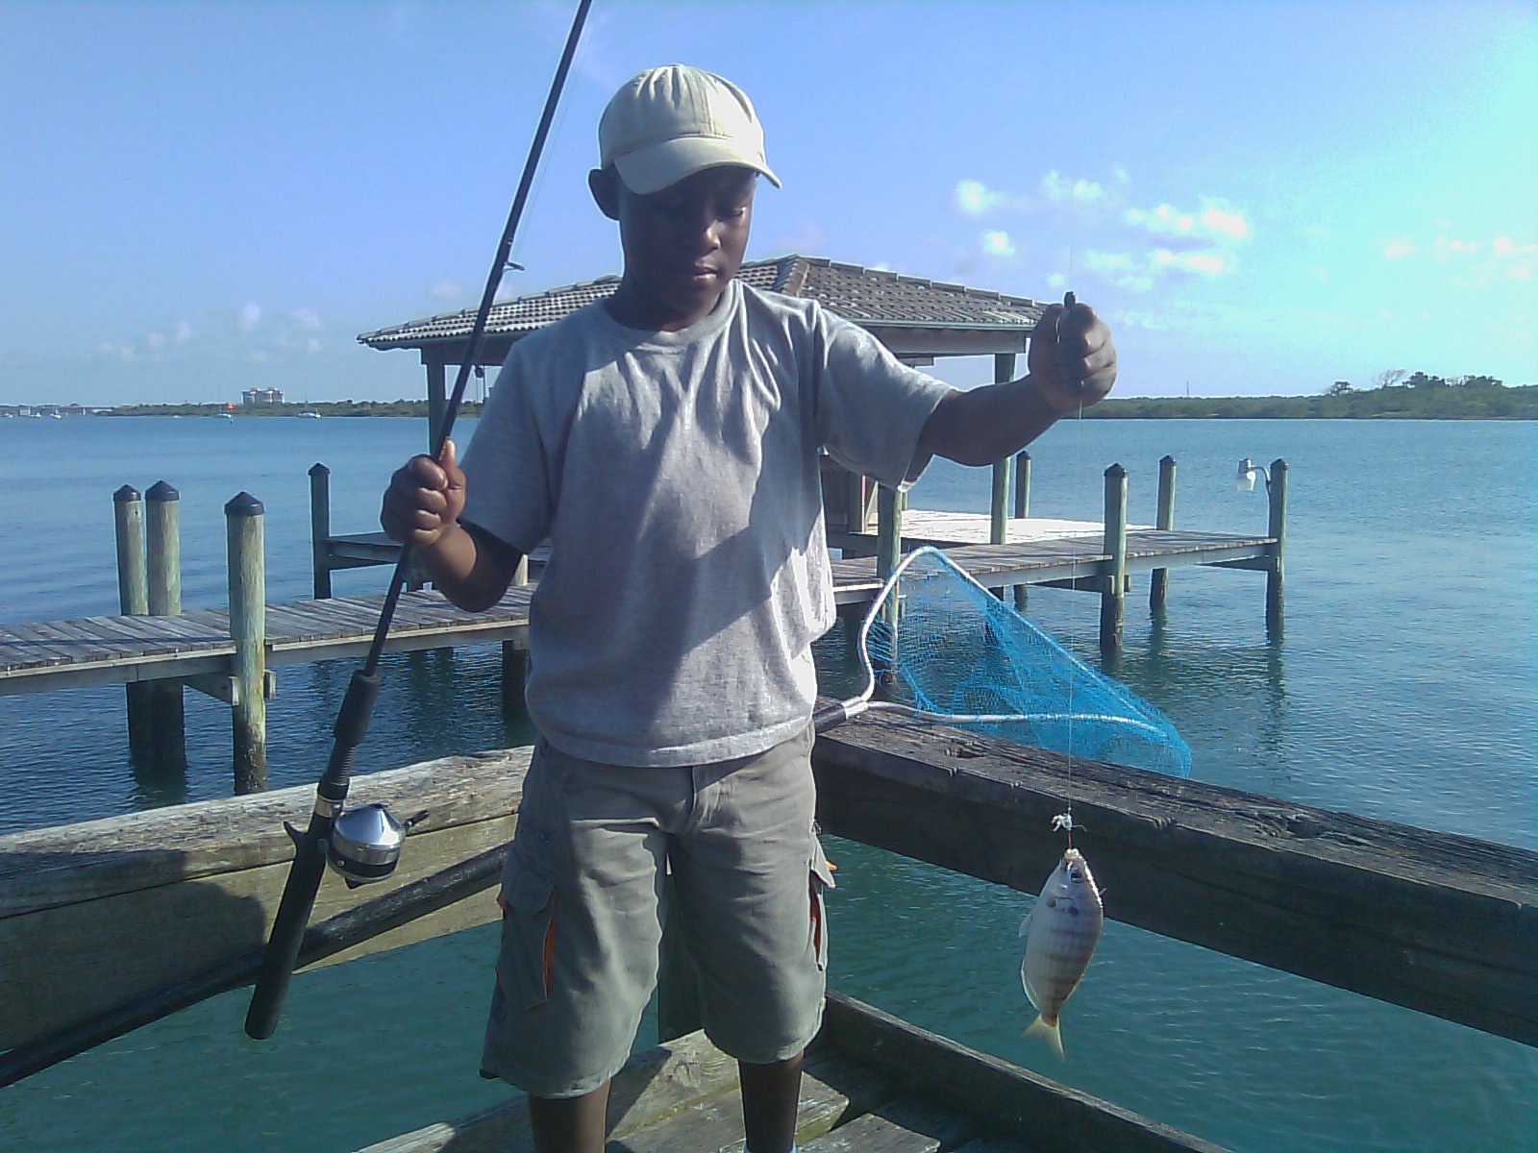

Slide 27
Major Facts and Concerns for Tourism and The Economy of The Bahamas

Slide 28
FACTS
Tourism is the major industry in The Bahamas and fishing is one of the top activities enjoyed by visitors.
According to the 2008 Visitor Expenditure Survey (The Bahamas Ministry of Tourism, 2009), flats and offshore fishing were undertaken by 11% of all stopover visitors and accounted for 20% of the expenditures on all recreational activities.

Slide 29
The Bahamas is known as a world-class bonefishing destination by anglers from around the world
This reputation is based on the perception of high quality fisheries resources and fishing experiences compared to other fishing destinations throughout the Caribbean, Central America and the world.

Slide 30
Anglers traveling to The Bahamas to fish for bonefish and other flats species contribute to the Bahamian economy in two important ways.
Some Anglers hire independent guides and purchase lodging, meals, equipment, supplies, transportation, and other items separately.
Others pay a “package price” to a fishing lodge which normally includes guided fishing, lodging, meals, and transportation in The Bahamas. Both independent fishing guides and fishing lodges generate income and jobs for The Bahamas.

Slide 31
Concerns and Capacity Needs
1. A water resource management plan needs to be developed for Andros that would include protected forest areas/aquifer protection zones, and a recommended local planning process for proposed developments, in particular for significant potential threats to the water resources such as quarries, marinas and major resort developments in excess of
30 rooms.

Slide 32
2.The environment is at the heart of our way of life. The costs arising from its use must be balanced with the benefits now and for the future. Its sustainable use for unborn generations must be secured. The pressure from increased population, greater tourism and the cumulative impact of use will affect the long term quality of the environment. Consequently, we must ensure that in using it, we secure in law, and nurture in practice, this fragile but renewable resource.

Slide 33
3. Forging new linkages with the Ministry of Tourism and Tourism Sectors in an effort to further sustain protected and cultural resources.
4. Management Planning (or lack thereof) is needed to reflect stakeholder involvement and provide direction for operations.
5. Building Community Support and Political Will
6. There is a need to expand protected areas in order to fill ecological gaps.

Slide 34
7. Implementation of National Strategy on Invasive Species
8. Establishment of sustainable financing for protected areas
9. Enforcement of laws and policies for designated and protected areas.
10. Others

Slide 35
How Do We Protect
Our Unique Biodiversity?
Through Legal and Institutional Policy
and Planning

Slide 36
What Do We Have In Place?
Planning and Subdivision’s Act - which seeks to
  Promote sustainable development in a healthy and
natural environment
  Maintain and improve the quality of the physical and natural environment
  Protect and conserve the natural and cultural heritage of The Bahamas
Forestry Act
Created to protect the forestry zones of The Bahamas

Slide 37
National Environmental Policy for the
Commonwealth of The Bahamas seek to:
  prevent, reduce or eliminate various forms of pollution to ensure adequate protection of the environment and the health of its citizens
  Conserve the biological diversity of the country and the stability, integrity, resilience and productivity of ecosystems; and
  Provide for environment to be fully integrated in policies, plans, programs, and development project decisions that might be detrimental to the continued health, safety and productivity of the country’s environment.

Slide 38
The Bahamas National Trust (Amendment) Act
  Advises the Government as well as public and private sector entities on development issues and the policies relating to conservation, the environment, biodiversity, natural and cultural heritage and resource management.
The Fisheries Resources (Jurisdiction and Conservation) Legislation
  An Act to make provision with respect to the conservation and management of the fishery resources of The Bahamas and to extend the limits of the jurisdiction of The Bahamas over such fishery resources and for matters connected therewith or incidental thereto.

Slide 39
The Bahamas Environment, Science and Technology Commission
The Bahamas Environment, Science & Technology Commission also known as the BEST Commission was established in 1994. The BEST Commission manages the implementation of multilateral environmental agreements and reviews environmental impact assessments and environmental management plans for development projects within The Bahamas.
In addition, the team reviews the environmental aspects of various government infrastructure projects and responds to queries regarding the environment and environmental planning and protection.

Slide 40







Is Education the Answer?

Slide 41
YES!!
Institutional Strengthening
Small Island Sustainability Programme
“Learning through transformation and transformation through learning”
The College of The Bahamas through is new signature program in Small Island Sustainability was created specifically to assist in the development of environmental and sustainability strategies for SISs.
The baccalaureate degree offers concentrations in:
Environmental and Ecosystems Management; Sustainable Agriculture; Ecotourism and Development; Policy Studies and Integrated Development Planning

Slide 42
Other Ways of Mitigation
Sustained annual funding as a key to conservation
Data management and research capabilities
Monitoring and compliance
While major city centers in The Bahamas such as Nassau and Grand Bahama have attracted large- scale tourist development, the Government and by extension, the Ministry of Tourism, have been actively pushing for the development of small-scaled tourism development that are considered more sustainable to/for small island stated.

Slide 43
Thank You For Your Attention

