Slide 1



Earth Observation Support for Tourism:
The view from the end user
Deirdre Shurland, Coordinator – Caribbean Initiative
IUCN Regional Office for Mesoamerica & the Caribbean Initiative
www.iucn.org/caribe
IUCN_Caribbean

Slide 2
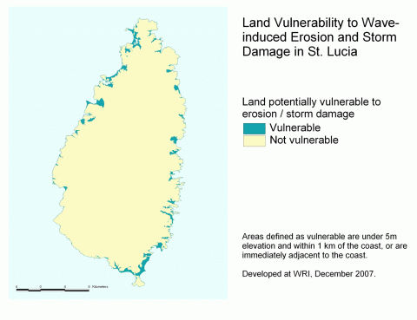
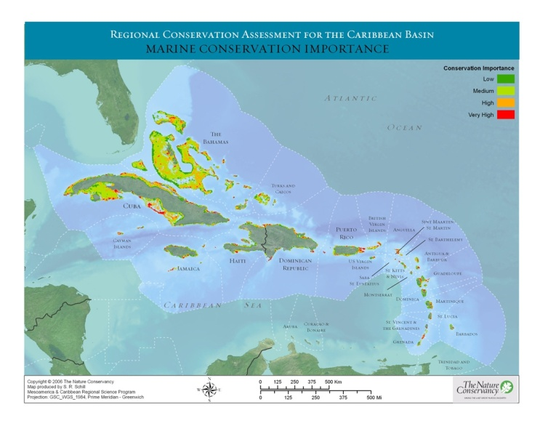
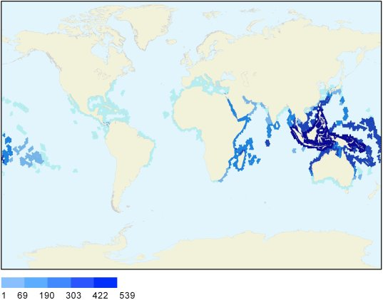
WHO are the key
Data “End Users”
PUBLIC SECTOR:
Decision-Makers (politicians, parliamentarians)
Planners, analysts
PRIVATE SECTOR:
  Financiers
  Planners, Architects, Designers
  Managers, staff
  Tour Operators (Int´l)
COMMUNITY:
  Farmers, fishers
  Local tour operators
  Divers
  Youth
Source: WRI
Source: IUCN Red List – Coral Richness

Slide 3
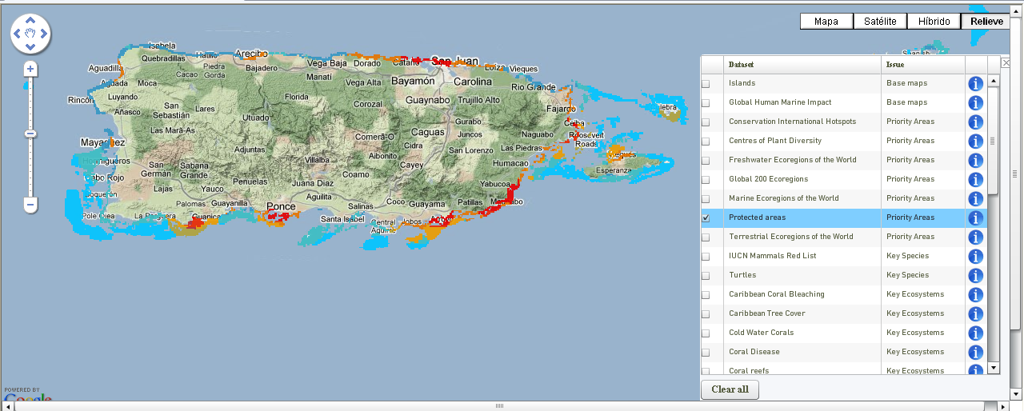
Interactive: Global Islands Database
Partnership:
UNEP WCMC
CBD
Italian Ministry of Foreign Affairs
GLISPA
Global Islands Network (GIN)
Etc.
http://gid.unep-wcmc.org/
Some Examples of Biodiversity Interactive Databases:
UNEP World Conservation Monitoring Centre: http://www.unep-wcmc.org/
ISDR´s Global Risk Data Platform: http://www.preventionweb.net/english/maps/index.php
World Database on Protected Areas
ProtectedPlanet.net: searchable by country
Integrated Biodiversity Assessment Tool (IBAT): www.ibatforbusiness.org
US Gov Agencies: e.g. NOAA, USGS, NHC

Slide 4
Challenges:
Global
Regional
Local
Data resolution
Poor coverage in some islands
Dated information
Multiple data locations and sites
Not user-friendly
Costly
Inaccessible

Slide 5
“Views”:
PUBLIC SECTOR: national patrimony, economic opportunity
Decision-Makers (politicians, parliamentarians)
Planners, analysts
PRIVATE SECTOR: Real estate, property, development opportunity,
  Financiers
  Planners, Architects, Designers
  Managers, staff
  Tour Operators (Int´l)
COMMUNITY: Resource, livelihoods, tradition
  Farmers, fishers
  Local tour operators
  Divers
  Youth

Slide 6
IUCN Caribbean Initiative as “end user”:
Core focus on conservation of biodiversity
Influencing policy
Changing behaviours
Ecosystem based approaches
Results on the ground
Continuous learning and knowledge

Slide 7
PURPOSE:
Goals for the 2011 – 2020 CBD Strategic Plan:
Address the underlying causes of biodiversity loss by mainstreaming biodiversity across government and society
Reduce the direct pressures on biodiversity and promote sustainable use
improve the status of biodiversity by safeguarding ecosystems, species and genetic diversity
Enhance the benefits to all from biodiversity and ecosystem services
Enhance Implementation through participatory planning, knowledge management and capacity building

Slide 8
CBD Actions:
Communication:
Education and awareness
Appropriate incentive measures
Institutional changes
Targets:
  Local authorities, parliamentarians, business, youth, scientific community, NGOs

Slide 9
IUCN support:
Focus on ecosystem based approaches:
  Island ecosystems
  Continuum between watersheds & coasts
  Management units e.g. river basins, watersheds, reef complexes, protected areas
  Diverse and functional management systems

Slide 10
Questions:
To what extent should island states continue to invest in 1º data assembly, collation and analysis or rely on 3rd party databases and tools?
How accessible should these be to states? Free? Minimal cost recovery? Market prices?
What is the progress on more user friendly interfaces and online data bases:
  Dynamic tools
  3D analyses
  Consolidation of databases across agencies

